Slide 1
Darien Men’s Association
U.S. Federal, State and Local Fiscal Challenges and How To Address Them
Darien, CT
October 26, 2016
Presented by
The Honorable David M. Walker, Senior Strategic Advisor for PwC & Former U.S. Comptroller General

Slide 2
Federal Government has Grown Dramatically
1912
2015
Federal Spending
$277 Billion in 2015 Dollars
Federal Spending
$3.7 Trillion in 2015 Dollars
Source: Historical Statistics of the United States, Millennial Edition On Line, Cambridge 2006; Congressional Budget Office, March 2015.

Slide 3
Losing Control of the Budget
2015
Source: Historical Statistics of the United States, Millennial Edition On Line, Table Ea636–643 Federal government expenditure, by major function: 1789–1970. Congressional Budget Office, March. 2015.
Notes:
2133% increase in mandatory control of budget. Our budget is out of control.

Slide 4
Federal Spending and Revenues 1912-2015

Slide 5
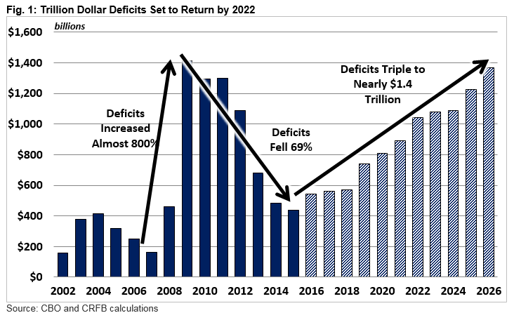
Trillion Dollar Deficits Are Coming Back

Slide 6
Federal Debt Held by the Public as a Share of GDP
Source: Government Accountability Office, 2015.

Slide 7
Holders of Federal Debt

Slide 8
Federal Financial Sink Hole
$65.0 Trillion
(Your Share $203,826)
$20.4 Trillion
(Your Share $72,500)
Source: Data from the Department of Treasury, 2015 Financial Report of the United States Government.
Notes:
http://www.fms.treas.gov/frsummary/FR-Summary-2013.pdf
Population 319848440

Slide 9
Looming Social Security Insolvency
Social Security Costs and Revenues (Percent of GDP)
23% Percent Benefit Cut
Source: 2013 Social Security Trustees Report.

Slide 10
Relative Taxpayer Surplus/Burden by State
1. | Alaska (5) | 77.3%
2. | North Dakota (1) | 46.8%
3. | Wyoming (2) | 40.6%
4. | South Dakota (2) | 7.5%
5. | Utah (1) | 6.6%
6. | Nebraska (1) | 4.9%
7. | Idaho (2) | 4.5%
8. | Oregon (3) | 3.6%
9. | Tennessee (2) | 3.0%
10. | Montana (3) | 1.8%
11. | Iowa (1) | 1.6%
12. | Indiana (1) | 1.5%
13. | Virginia (1) | 2.3%
14. | Florida (2) | 2.1%
15. | Arkansas (4) | 3.3%
15. | Minnesota (2) | 3.3%
17. | Oklahoma (2) | 4.7%
18. | Nevada (3) | 5.4%
18. | Colorado (1) | 5.4%
20. | Missouri (3) | 6.0%
21. | New Hampshire (3) | 6.4%
22. | Arizona (3) | 6.7%
23. | Wisconsin (2) | 7.1%
23. | Ohio (2) | 7.1%
25. | Georgia (1) | 9.1%
26. | Kansas (3) | 12.5%
27. | Washington (2) | 14.4%
28. | Texas (1) | 15.4%
29. | Maine (5) | 17.0%
30. | Maryland (4) | 17.3%
31. | North Carolina (1) | 18.0%
32. | South Carolina (3) | 21.6%
32. | New Mexico (4) | 21.8%
34. | Rhode Island (5) | 23.0%
35. | Vermont (5) | 23.6%
36. | Mississippi (5) | 25.9%
37. | Pennsylvania (4) | 28.3%
38. | Delaware (3) | 30.2%
39. | Alabama (4) | 31.7%
40. | West Virginia (3) | 32.9%
41. | California (4) | 34.6%
42. | Michigan (4) | 34.8%
43. | Louisiana (4) | 35.8%
44. | Hawaii (5) | 37.2%
45. | New York (5) | 38.1%
46. | Massachusetts (3) | 43.4%
47. | Connecticut (5) | 69.3%
48. | Kentucky (4) | 76.2%
49. | New Jersey (5) | 80.2%
50. | Illinois (4) | 81.9%
Source: 2015, PwC State Financial Position Index (SFPI) and Competitiveness Posture Report (% of Median Household Income for the Applicable State)
Numbers in red denote burden per taxpayer, Numbers in black denote a surplus per taxpayer
Relative Competitive Posture By Quintile – (1), (2), (3), (4) and (5)
A complete copy of the PwC report can be found at http://pwc.to/1O6S85f

Slide 11
Common Denominators Between Federal and State Fiscal Challenges
Outdated tax systems
Excessive regulatory burdens
Unfunded retirement obligations
Escalating health care costs
Expensive yet ineffective welfare systems
Deteriorating critical infrastructure

Slide 12
Key Organizations in the Fiscal Space
No Labels (www.nolabels.org) – National Strategic Agenda
Committee for a Responsible Federal Budget (www.crfb.org) – First Budget
Concord Coalition (www.concordcoalition.org) – First Budget
Peter G. Peterson Foundation (www.pgpf.org) – Federal Fiscal Sustainability
AARP (www.aarp.org) – Social Security/Medicare Solvency, Retirement Savings and Security, Health Care, Long-term Care
Government Transformation Initiative (www.gti-coalition.org)
Committee for a Fiscal Responsibility Amendment (www.cffra.org) – Fiscal Responsibility Amendment
Institute for Truth Accounting (www.truthinaccounting.org) – State Fiscal Sustainability
Volcker Alliance (www.volckeralliance.org) – State Fiscal Sustainability

Slide 13
Current Major Presidential Candidates per CRFB
Donald Trump (R) – (PS-($500B); T-($5.8T); BL-$5.3T)
Hillary Clinton (D) – (PS-$1.7T; T-$1.5T; BL-$200B)
Legend:
S = Spending; T = Taxes; BL = Bottom Line over 10-Years
NEITHER CANDIDATE HAS ADDRESSED THE STRUCTURAL DEFICIT CHALLENGE

Slide 14
2012 $10 Million a Minute Tour
27 States, 10,000 Miles with Two Key Representative Town Hall Events
Fact-based, Non-partisan, Non-ideological, Goal Oriented, Principles and Values Based, and Solutions Oriented
Focused on a Long-term Debt/GDP Goal (i.e., 60% by 2030)
Six Key Principles/Values for Reform (i.e., Pro Growth, Socially Equitable, Culturally Acceptable, Mathematical Integrity, Politically Feasible, and Meaningful Bi-partisan Support)
Eight Areas for Reform (i.e., Budget Process and Controls, Social Security, Medicare/Medicaid, Health Care, Taxes, Defense, Government Organization and Operations, and Political Reforms)
Super-Majority Support for Priority, Goal, Principles/Values, and Proposed Packages of Reform (77-97%)
Find out more at www.deficitranger.com

Slide 15
Summary
Current Fiscal and Monetary Policies are Unsustainable
A Number of States and Some Municipalities Face Serious Fiscal Challenges and there are Several Common Denominators Underlying these Challenges
These Challenges can be met with Strong CEO Leadership and Different Approaches to Engaging the Public
We Need Non-Partisan Solutions that can Gain Bi-Partisan Support
We Need to Pursue Public Engagement and Private Consultations to Achieve Sustainable Success
Eventual Federal Reforms will have Significant Implications for States, Municipalities, Employers, Non-Profits, Benefit Plans and Individuals
It’s Not Too Late to Create a Better Future But We Need To Start Soon
It Will Take Patience, Persistence, Perseverance and Pain Before We Prevail, But Prevail We Must!

