Slide 1


Connecticut’s fiscal crisis: Why our deficit won’t die

Slide 2

Quiz
Jot down your answers
Imagine a state employee. What does he/she look like?
What are the three most important functions of state government?

Slide 3
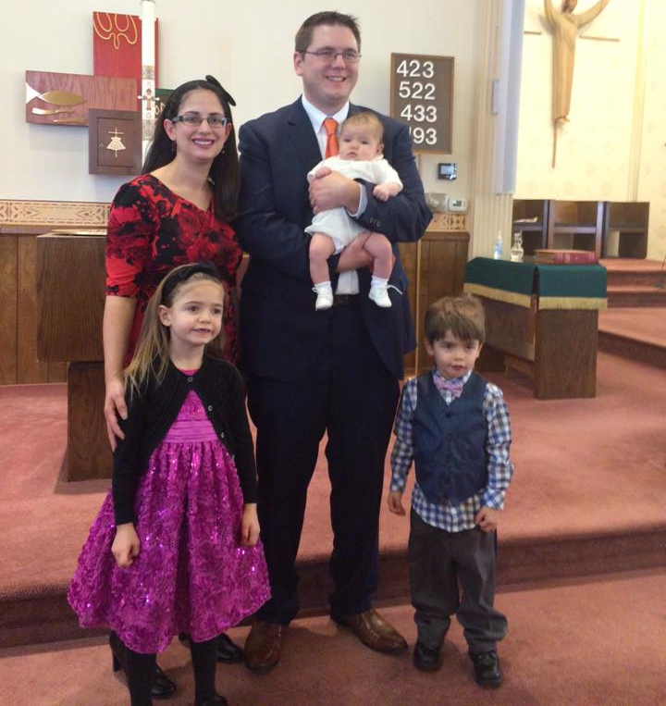
Yankee Institute
Free to succeed
Smart, limited government
Fairness for taxpayers
Open road to opportunity

Slide 4
The Problem
A Growing deficit
$1.4 billion in 2018
+$1.6 billion in 2019
= $3 billion over the biennium

Slide 5

Jobs?

Slide 6
Percent Real Wage Growth 2012-2016

Slide 7
But why?
Tax increases, service cuts, more deficits
Growth in some spending
>
Revenue growth

Slide 8
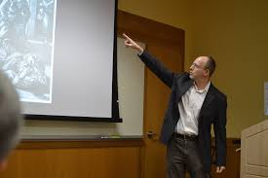

Back to the quiz
The most common state employees…

Slide 9

UConn = 4th branch

Slide 10
Question 2
Top 3 priorities
What are the essential functions of state government?

Slide 11
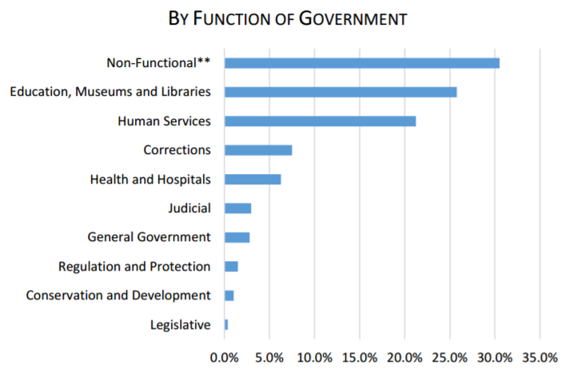
General fund =
$18 Billion
Transportation ($1.5 billion, special fund)

Slide 12
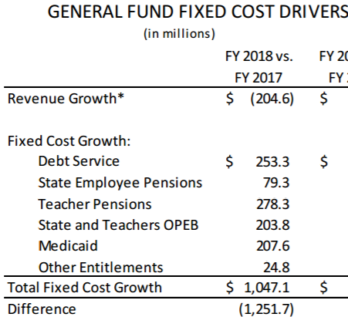
Spending growth
Top 3 priorities
What are the essential functions of state government?

Slide 13
Solutions
How to EARN a taxpayer bailout
Cap spending
Set priorities
Reform pensions
Rebalance compensation
Freeze borrowing

Slide 14
Thank You!
Any questions?

