Slide 1
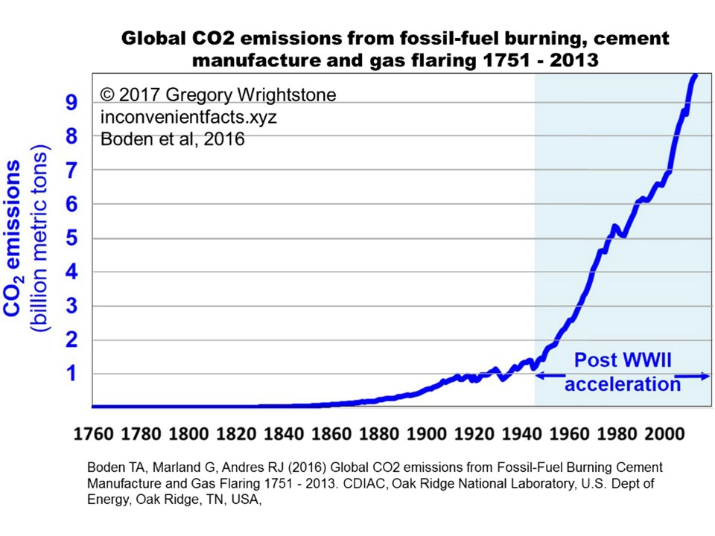
Notes:
This chart shows global man-made CO2 emissions began rising very slightly in the late 1800s, with a significant acceleration beginning in the mid-20th Century.

Slide 2
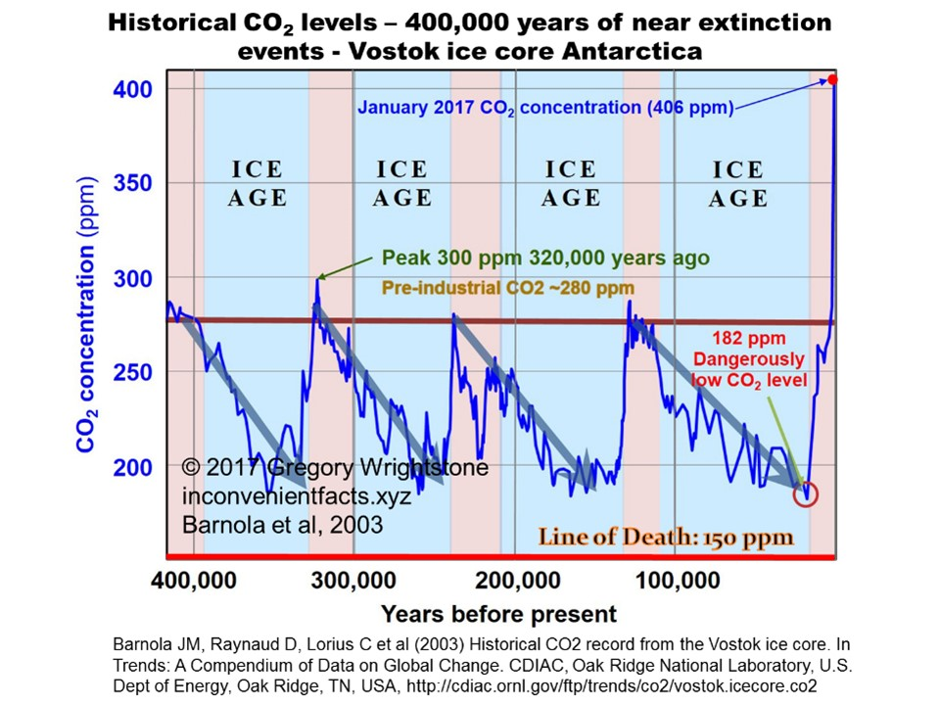
Notes:
A 40% increase in atmospheric CO₂ concentration, from 280 ppm in 1750 to 406 ppm in 2017, is widely accepted to be mainly man-made. Note that the red line is minimum CO2 needed for most plant life. We came within 30 ppm of total planetary annihilation of all higher life on Earth at the end of the last Ice Age, which was the lowest in Earth’s history.

Slide 3
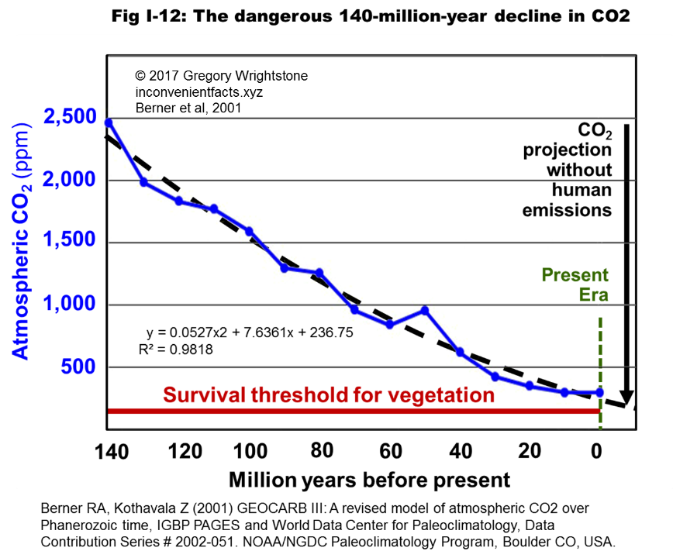
Notes:
The last 140 million years of CO2 concentration shows a nearly linear decline from 4,000 ppm to levels near to the “line of death” of 150 ppm, below which most plant life cannot exist. Reaching that level would be a true climate apocalypse.

Slide 4
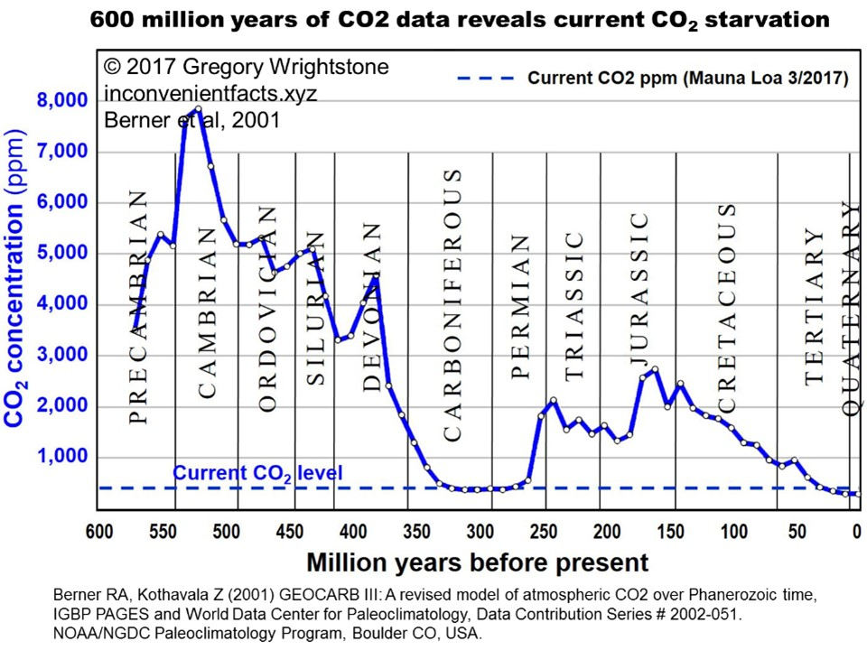
Notes:
Our current geologic period has the lowest average CO₂ levels in all of Earth’s long history. The average CO₂ concentration for the 600 million previous years was 2,600 ppm. We are not in an era of extraordinarily high CO₂, we are in an era of CO₂ starvation.

Slide 5
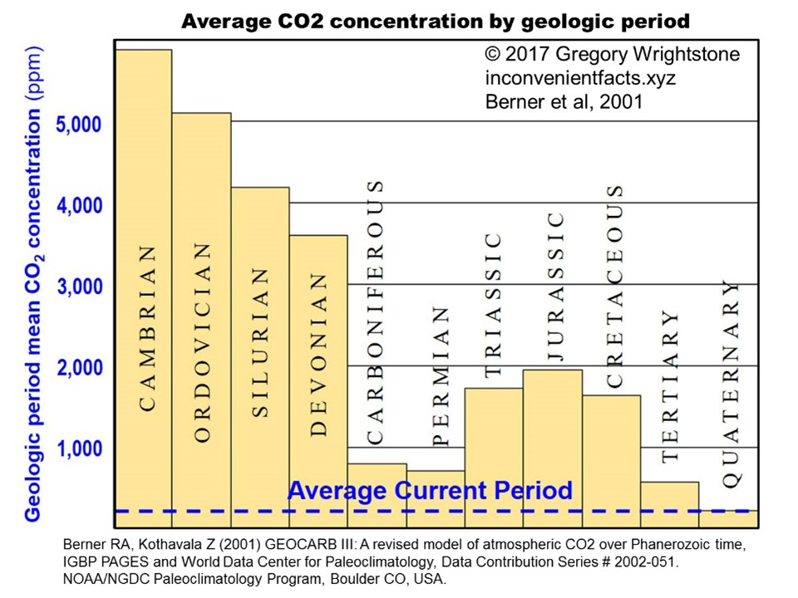
Notes:
Our current geologic period (Quaternary) has the lowest CO2 levels in all of Earth’s long history. The average CO2 concentration prior to the Quaternary and dating back to the PreCambrian was 2,600 ppm. Our current level of ~406 ppm (January 2017) is tiny in comparison to Earth’s historical levels.

Slide 6
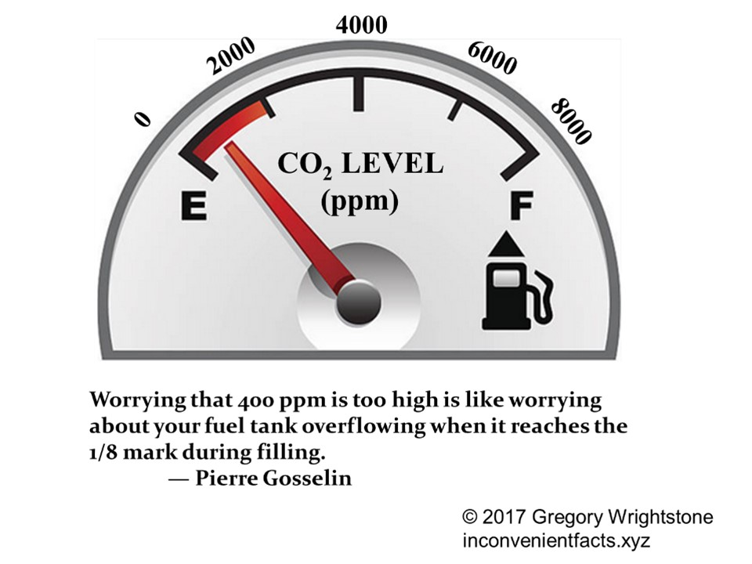

Slide 7
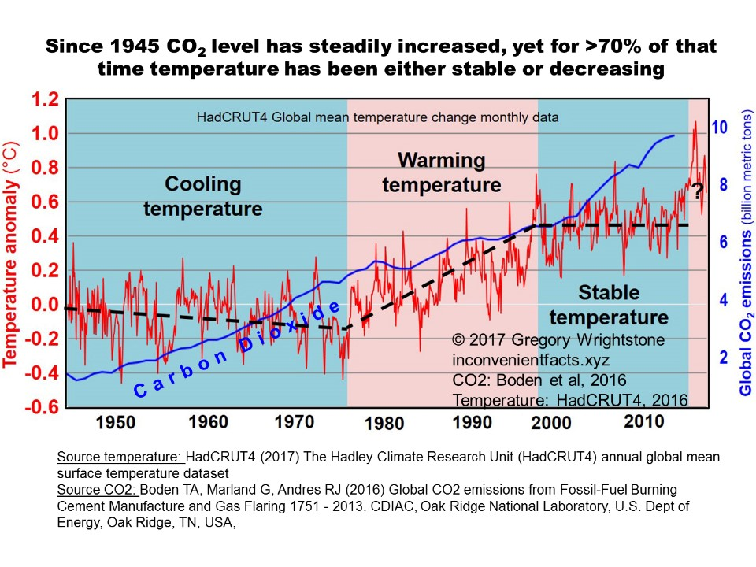
Notes:
Significant carbon dioxide emissions didn’t start ramping up until shortly after the end of the Second World War. Yet, since 1945, more than 70% of that time frame included periods of either declining or flat temperatures.
During two long periods of time from 1945 to 1979 and from 1998 to 2015,
temperatures either ceased increasing or actually fell. Both of these long periods coincided with rising CO₂. If CO₂ is driving dangerous warming, as the promoters of catastrophic anthropogenic global warming (CAGW) would have us believe, why did more than 70% of the postwar period show stable or even falling temperatures despite the fact that CO2 concentrations were inexorably rising?

Slide 8
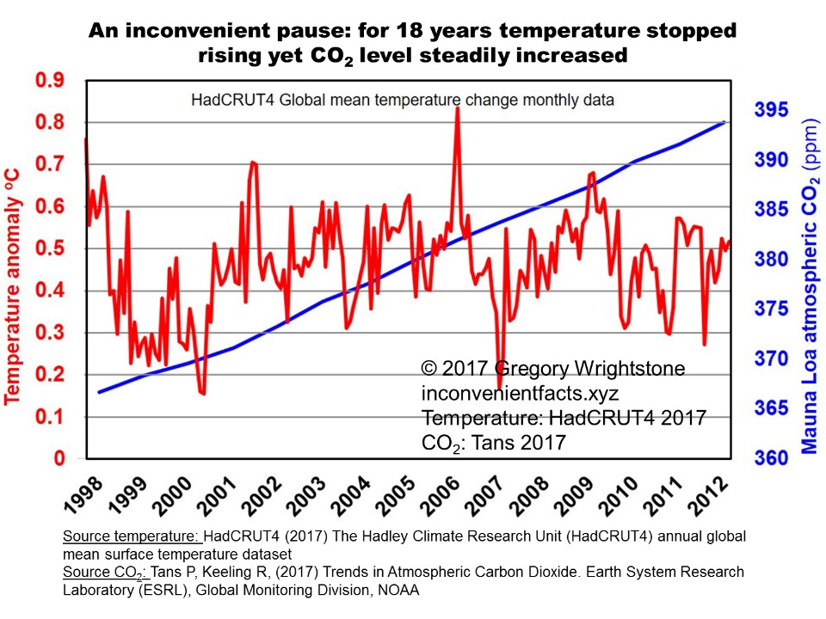
Notes:
Beginning in 1998, an 18 year period began in which temperature stopped increasing, all the while CO2 continued rising, known as the “Inconvenient Pause.” If you can’t explain the pause, you can’t explain the cause. (Hockey Schtick)

Slide 9
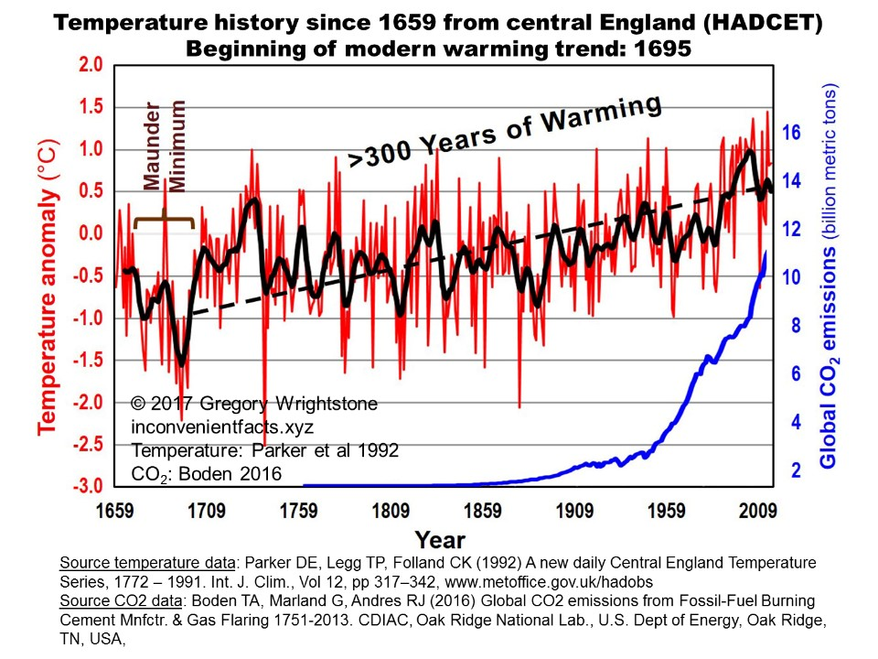
Notes:
Our current warming trend began in the year 1695 and the rate of warming for the next 40 years was the highest since that time and four times the rate of warming in the 20th Century.

Slide 10
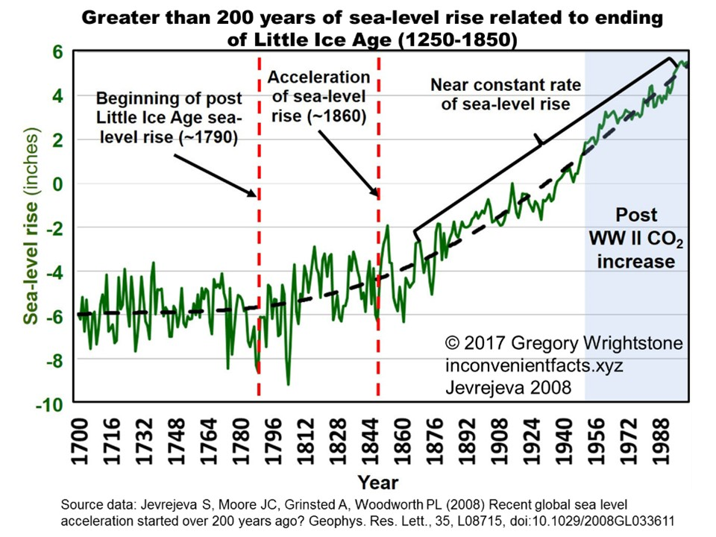
Notes:
Warming began in 1695, but didn’t warm enough until about 1800 to begin glacial retreat and cause ocean levels to resume their relentless rise. Rate of sea-level rise has remained nearly constant since the mid-1800s.

Slide 11
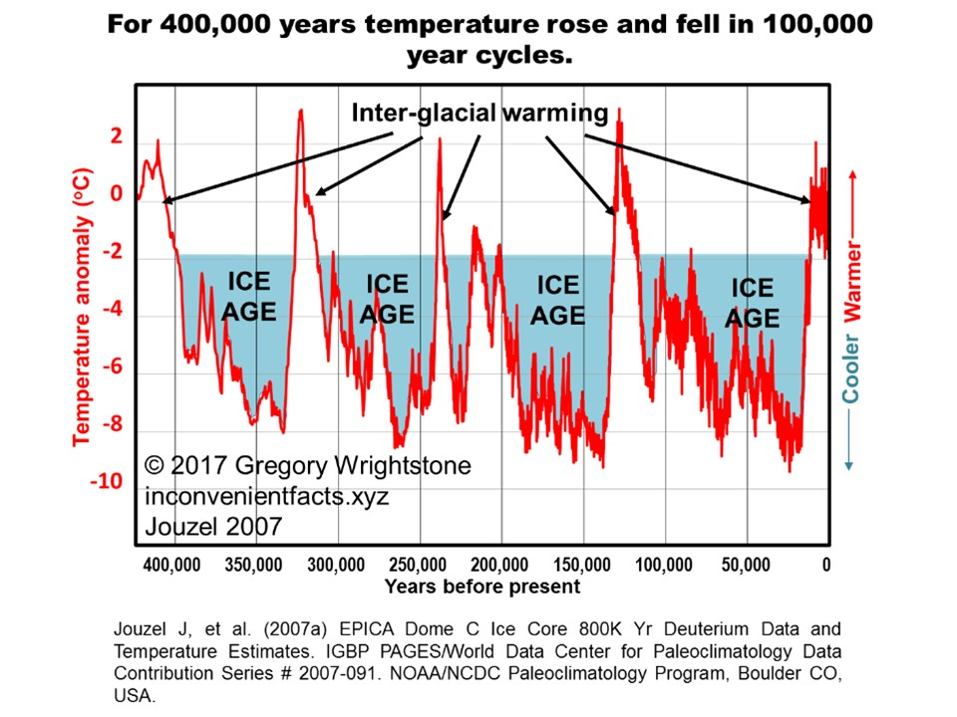
Notes:
For 400,000 years temperature rose and fell in 100,000 year cycles. Each previous warming period had higher temperatures than the 20th century and were entirely naturally driven, much like our current increase.

Slide 12
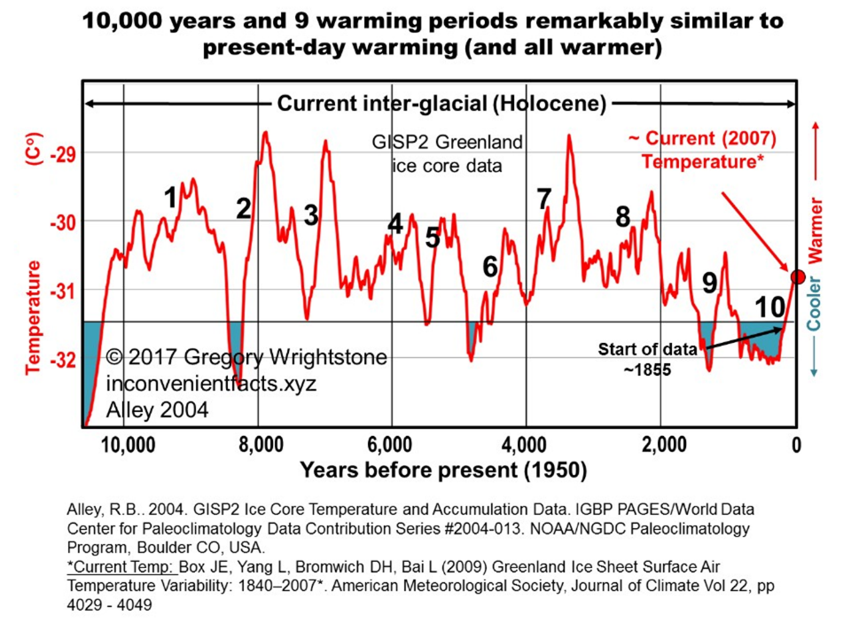
Notes:
For more than 6,100 years (or 60%) of the current interglacial warm period, the temperature was warmer than it is today.
Of the 9 earlier significant periods of warming since the end of the last ice age, 5 had higher rates of temperature increase & 7 had larger total increases in temperature.
Each of the previous warming cycles experienced significantly higher temperatures than today & were 100% naturally driven.

Slide 13
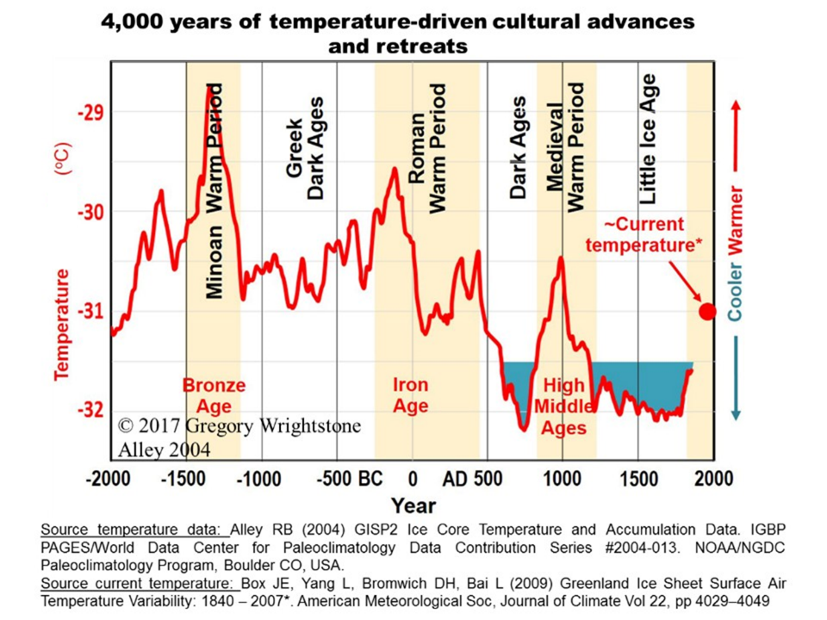
Notes:
Nearly all great advances in civilization and the human condition occurred during warm periods. Conversely, during cold periods, the human condition declined, accompanied by famine, disease and mass depopulation.

Slide 14
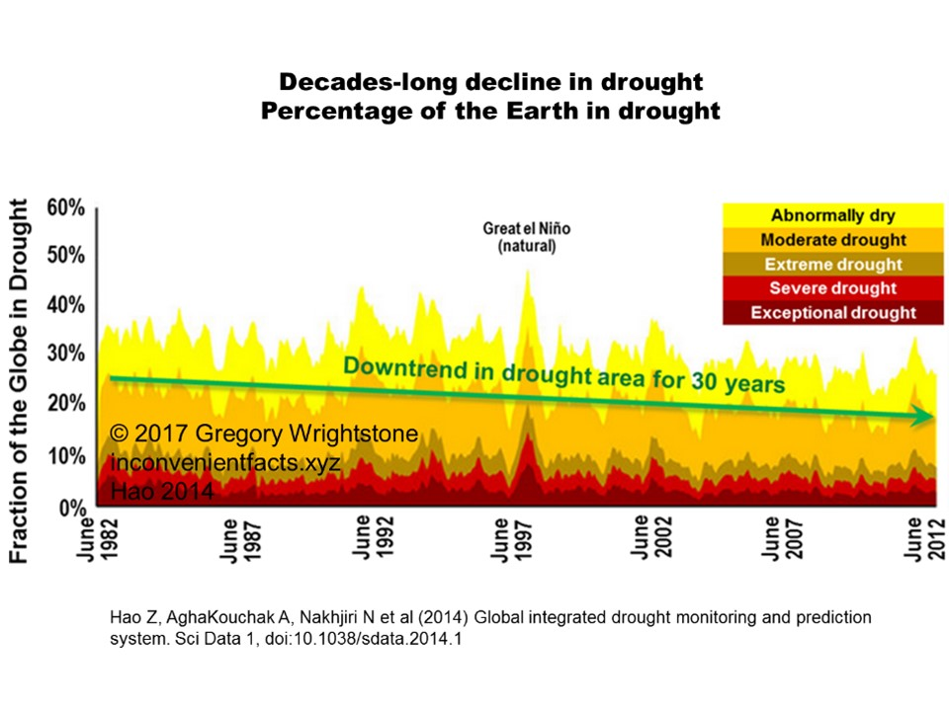
Notes:
The data reveals that droughts across the world have been in long-term decline.

Slide 15
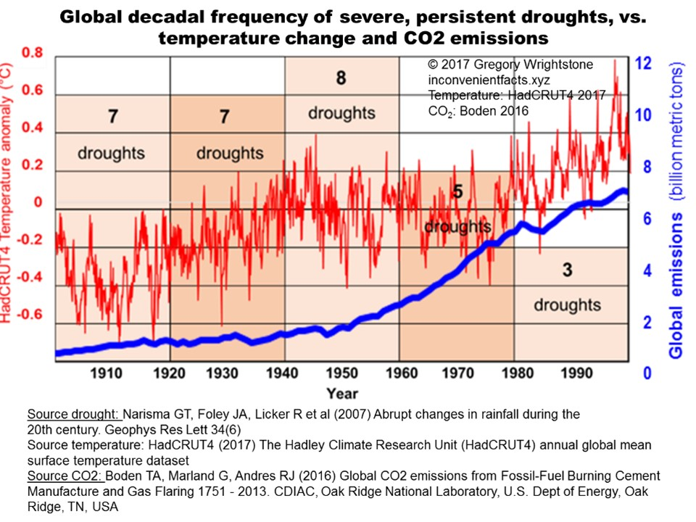
Notes:
A review of the most severe and persistent droughts of the 20th Century ID’d 30 of them. Curiously, nearly 75% of the droughts occurred before 1960, and well before the bulk of the surge in atmospheric CO₂. We are witnessing a significant decline in droughts, while both temperature and carbon dioxide increase, likely due to a combination of CO2 fertilization and rising temperatures.

Slide 16
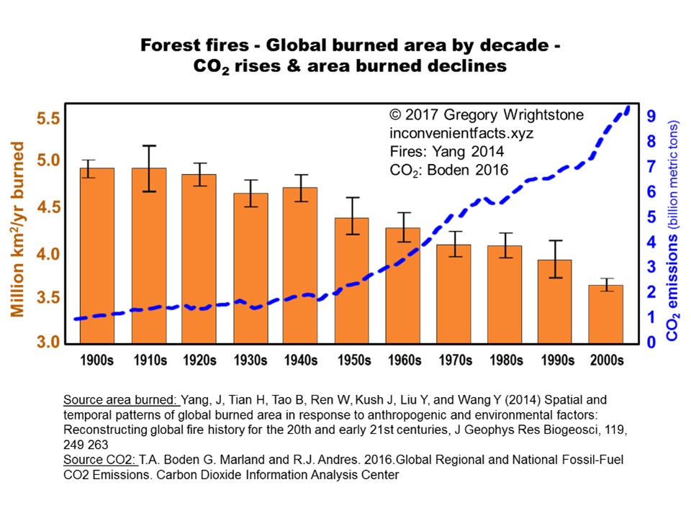
Notes:
The authors attributed the decline area burned by forest fires primarily to rising soil moisture content world-wide driven by increasing CO₂ concentrations & warming-driven water vapor increase. CO₂ fertilization has probably been suppressing fires since significant amounts of CO₂ began being added to the atmosphere in the 20th Century.

Slide 17
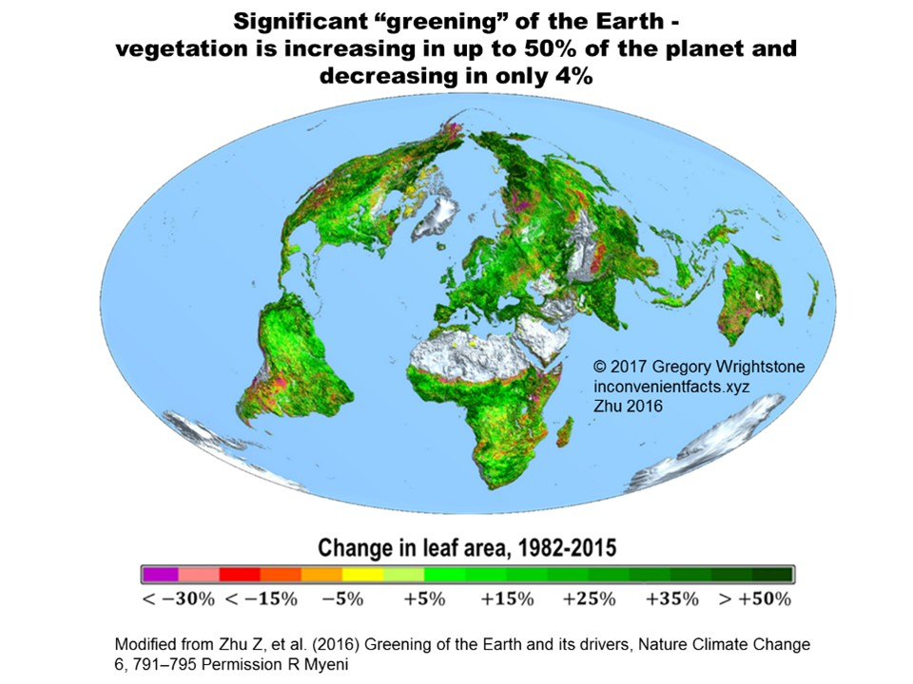
NASA (2016) Carbon Dioxide Fertilization Greening Earth, Study Finds, https://www.nasa.gov/feature/goddard/2016/carbon-dioxide-fertilization-greening-earth, accessed 3/13/17; permission R. Myneni
Notes:
According to NASA, Earth has been growing greener, not turning into a desert. Importantly, the authors (Zhu 2016) attribute the bulk of the greening to CO₂ fertilization effect. They estimate that 25 to 50% of the Earth is “greening” with only 4% experiencing “desertification.”

Slide 18
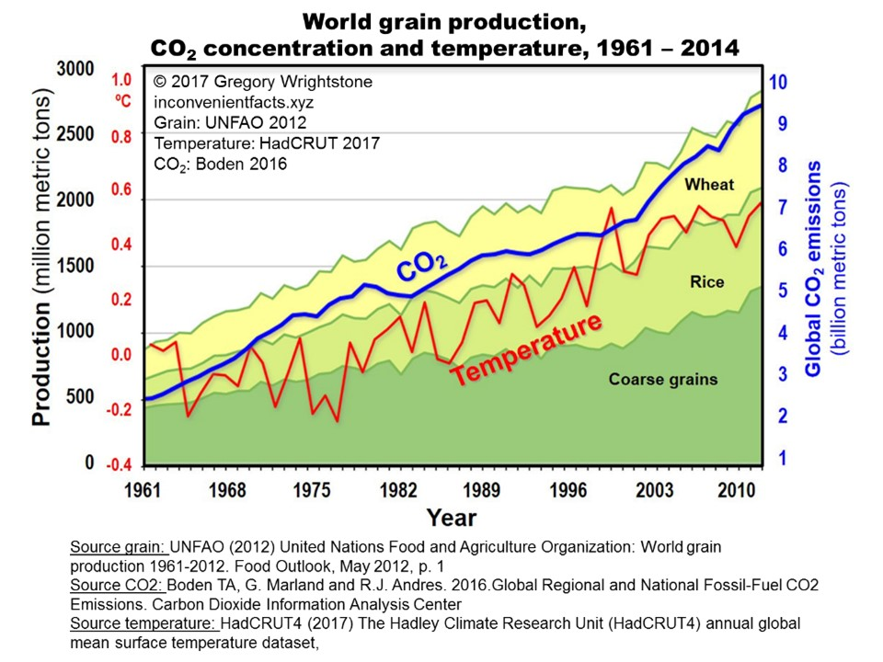
Notes:
The world’s remarkable ability to increase food production year after year is attributable to mechanization, agricultural innovation, CO₂ fertilization and warmer weather. World grain production and amount harvested per acre show that crop and food production has steadily increased, with only positive effects from our changing climate. Warming weather provides longer growing seasons.

Slide 19
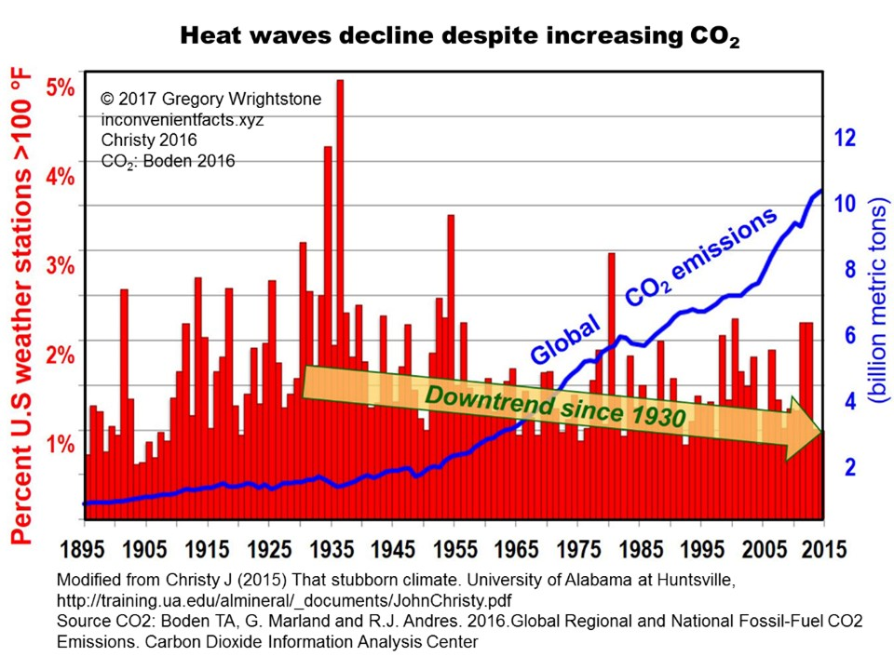
Notes:
Note that the lower 48 states of the U.S. have seen an 80-year decline in extreme heat.

Slide 20
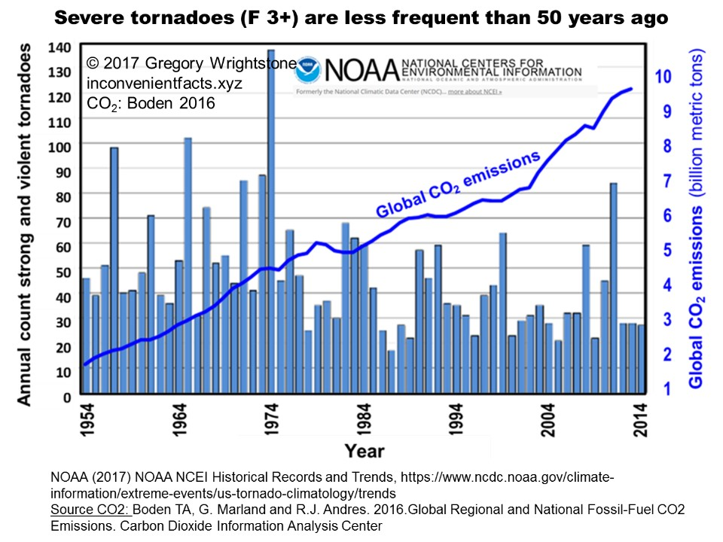
Notes:
There has been a long-term decline in tornado activity. The year 2016 ended with the lowest tornado count that NOAA has ever recorded

Slide 21
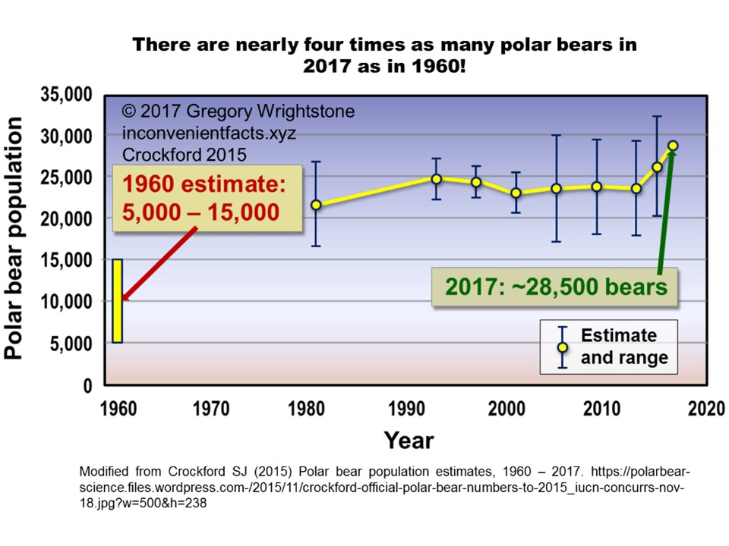
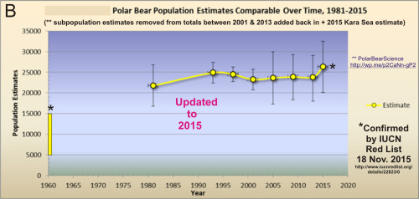
Notes:
There are at least three times as many polar bears today as in 1960. A recent review of Canadian polar bears found stable or increasing numbers in 12 of 13 sub-populations (York 2016). The researchers concluded: “We do not find support for the perspective that polar bears within or shared with Canada are currently in any sort of climate crisis.”

Slide 22
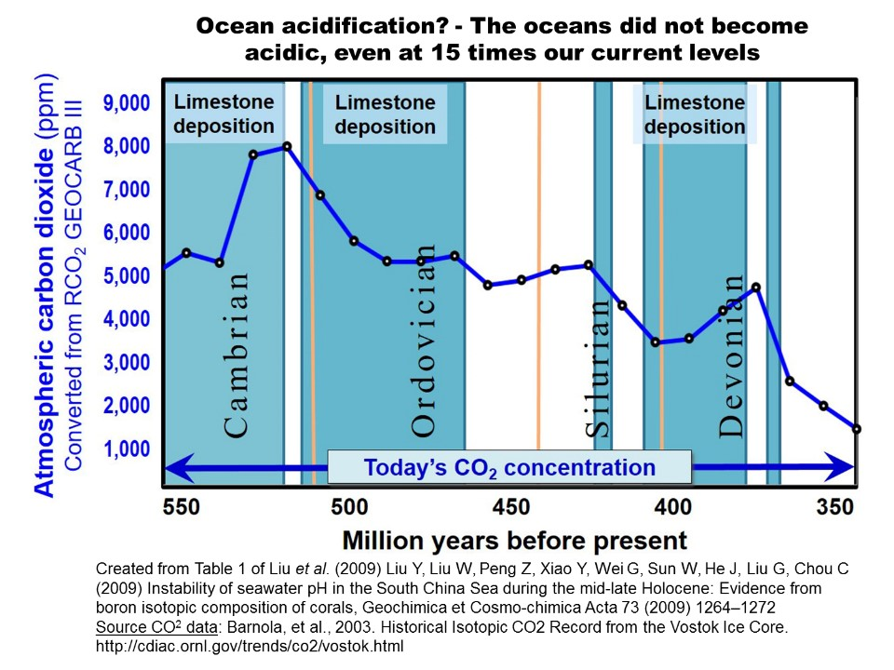
Notes:
During the early Paleozoic era, CO₂ usually exceeded 4,000 ppm, (10x today) yet the oceans never became acidic, as evidenced by deposition of carbonate rocks that dominated that time frame.

Slide 23
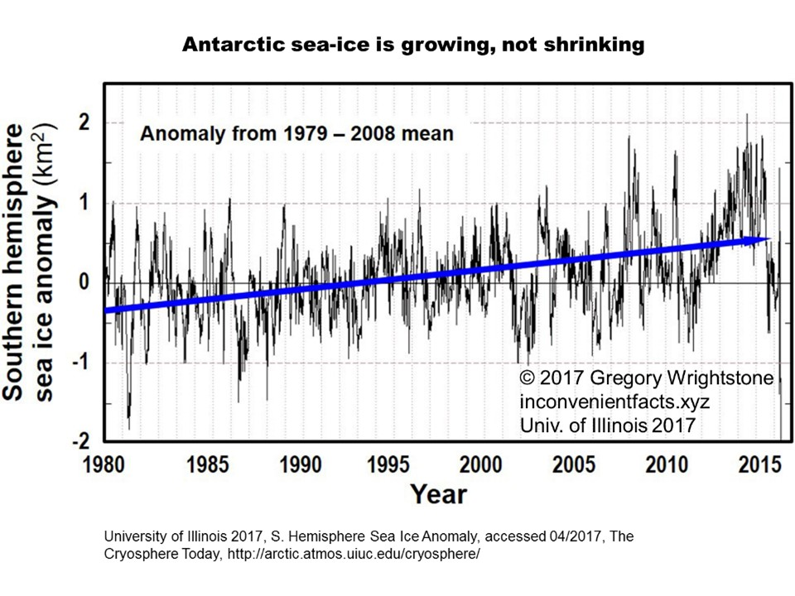
Notes:
Antarctic ice is increasing… by a lot. Focus of climate alarmists is on the Antarctic Peninsula and the ice shelves there. The reason is that it is the only portion of the continent that is warming, representing about 2% of the continent and due to ocean currents.

Slide 24
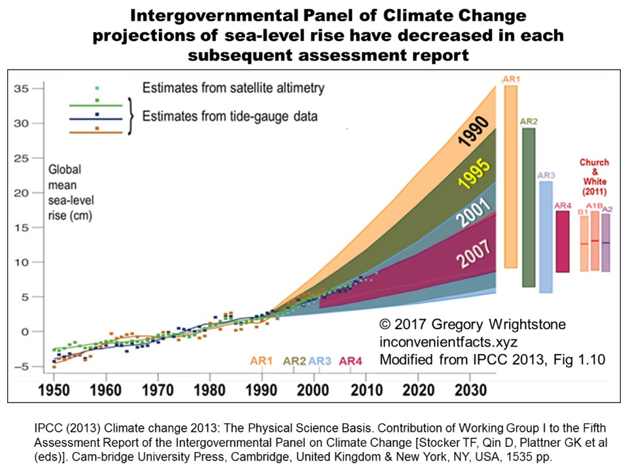
Notes:
IPCC has been compelled to reduce its sea-level predictions in each successive five-year Assessment Report, due to actual evidence and contrary to projections. The current projection is still wrong, just not as wrong as earlier ones.

Slide 25
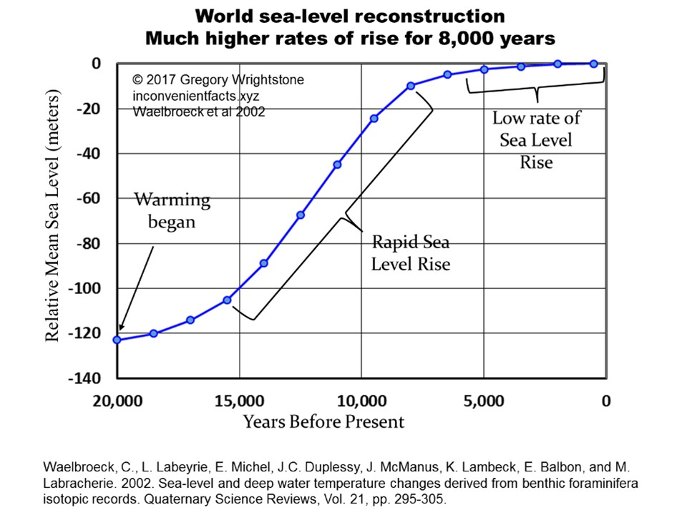
Notes:
Sea-level rise began more than 15,000 years ago, as we began to creep out of the last ice age. Data points for this chart are at 1,500 year increments, so smaller fluctuations of sea-level are not captured. Example: Medieval Warm Period rise and Little Ice Age drop are not captured in this data-set.

