Slide 1
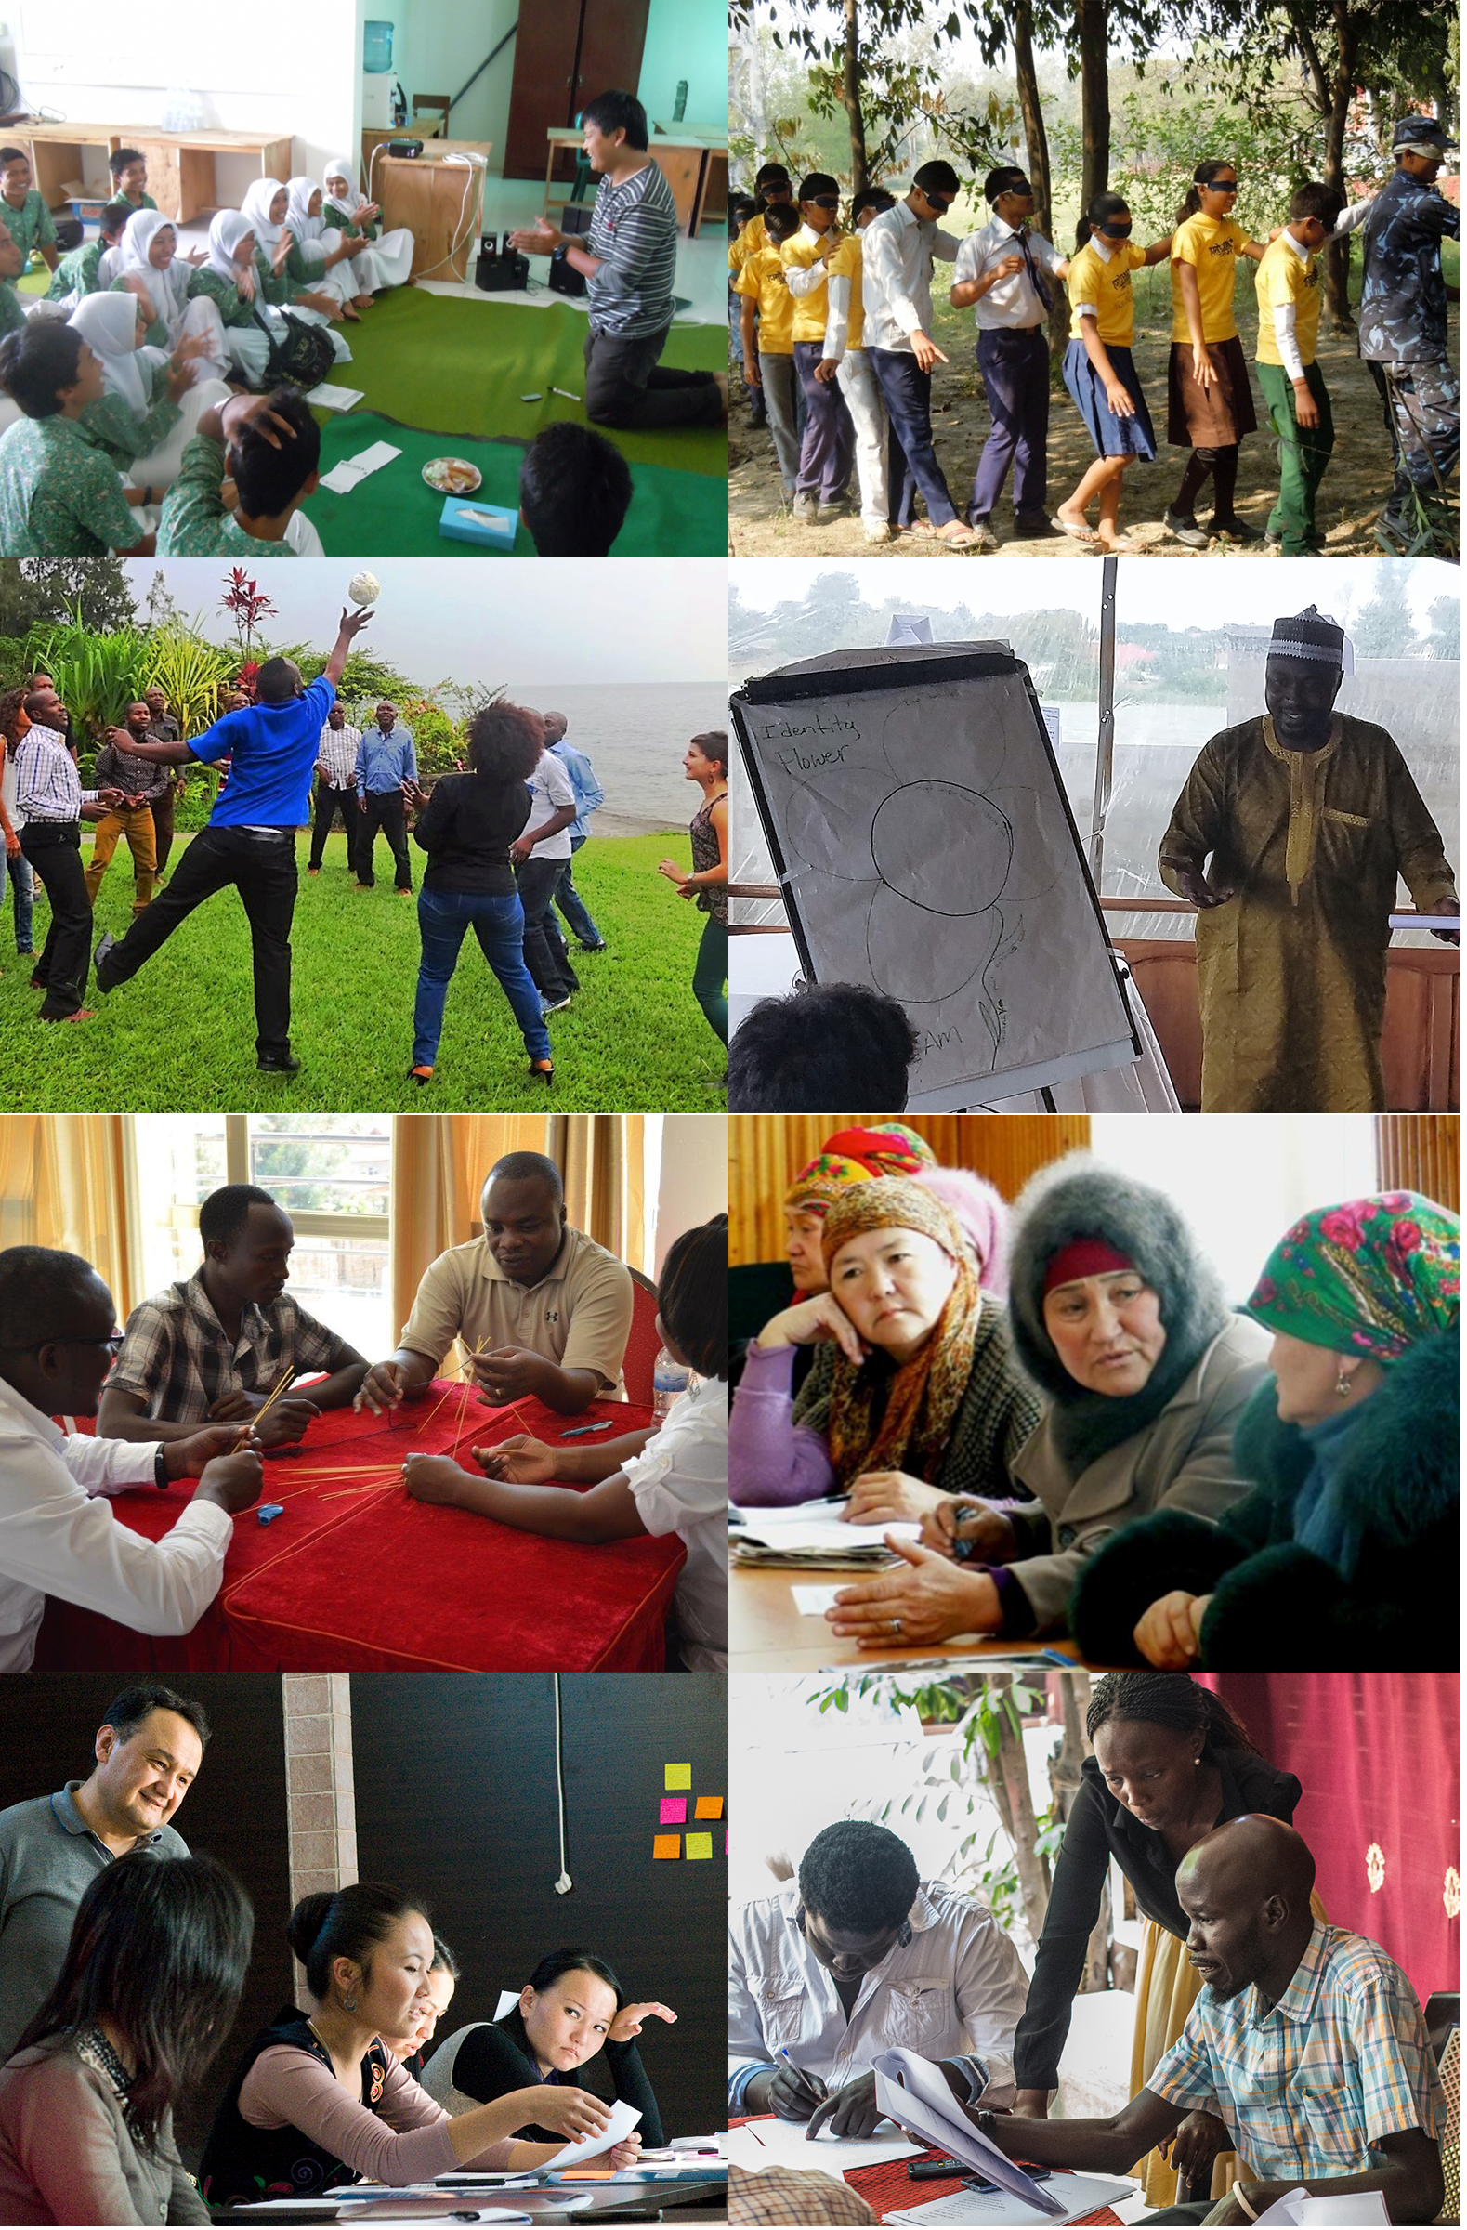
Trends in Global Conflict & Cooperation
Shamil Idriss
CEO, Search for Common Ground

Slide 2
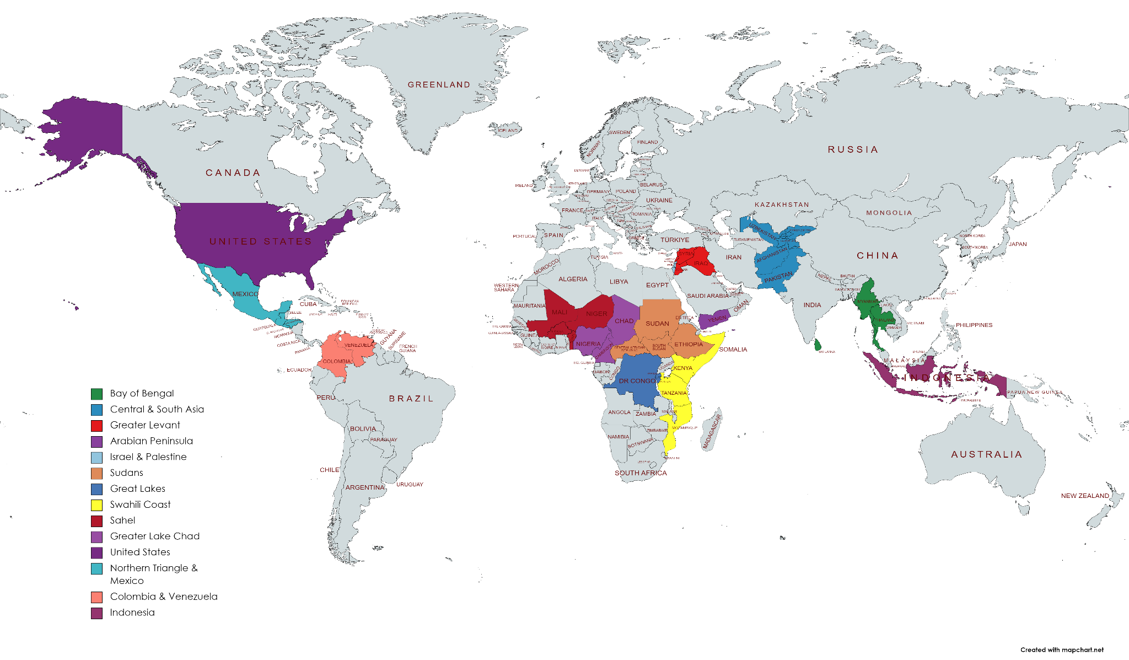
Where We Work
Founded 1982
150+ projects/year
50 million+ media reach
150,000 attend in-person events
800+ staff, 90% in home regions
850+ partner organizations
Recognition: Skoll Awardee; Nobel Prize Nominee; Hilton Humanitarian Award Finalist

Slide 3
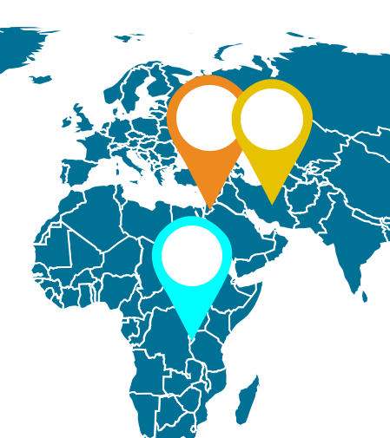
Success Snapshot
Negotiations we organized and facilitated produced language in the 1994 Israel-Jordan Peace Accord
Bi-lingual, interethnic schools we piloted in Macedonia at the height of Balkans conflict went nationwide
“Your work in Burundi helped to prevent genocide in the early 90s…and during the Iran (nuclear) talks, the fresh ideas you provided helped us to achieve a breakthrough on the Arak heavy-water reactor.”
—U.S. Secretary of State Kerry - 2016
Mediation programming we piloted in Morocco led to a nationwide mediation mandate & cottage industry of paid mediators

Slide 4
CONFLICT IS INEVITABLE, VIOLENCE IS NOT

Slide 5
Evolution of Peace & Conflict
What We Know About Preventing Violence & Fostering Cooperation
Take-Aways

Slide 6
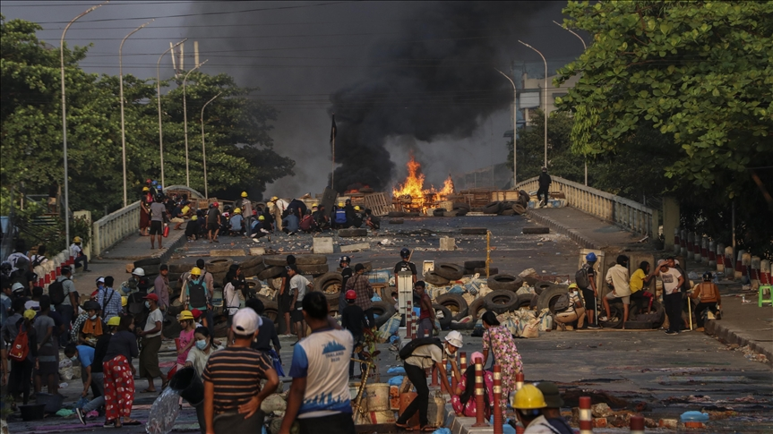
Evolution of Global Peace & Conflict

Slide 7
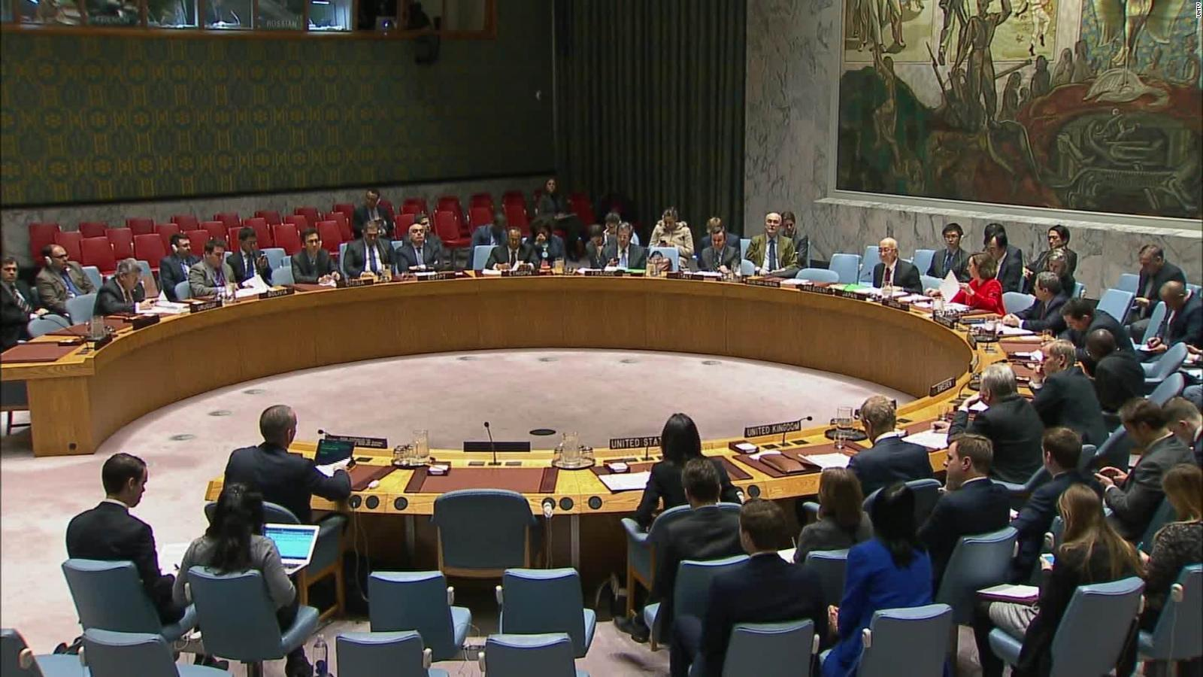
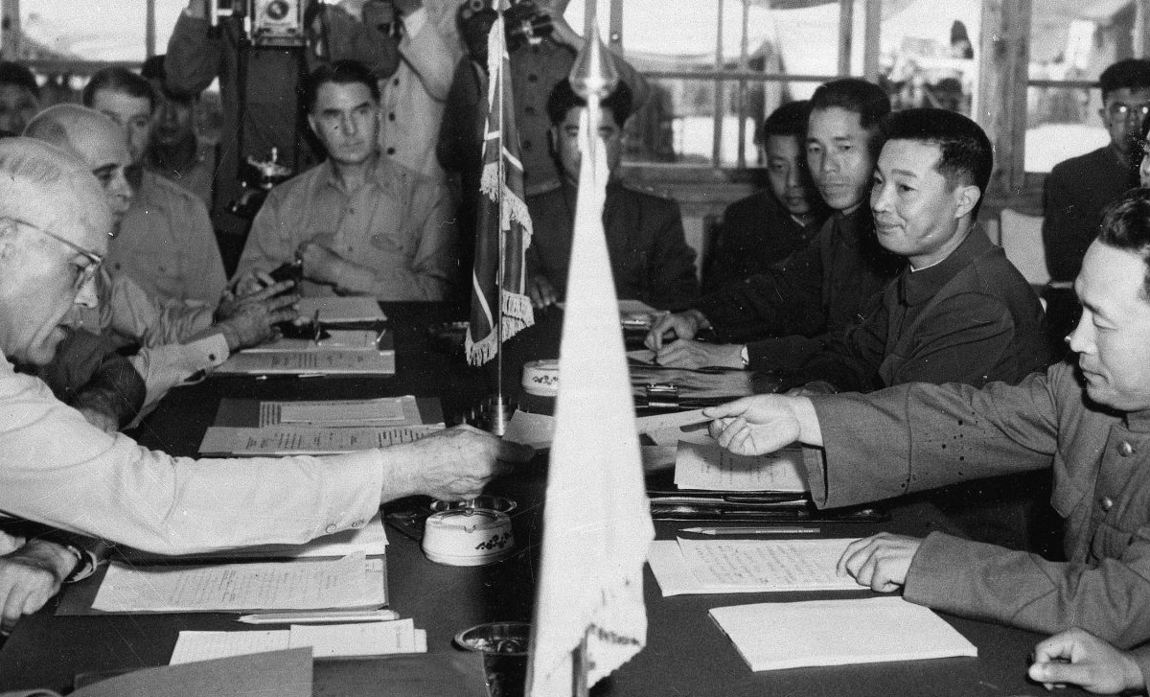
Since 1950

Slide 8
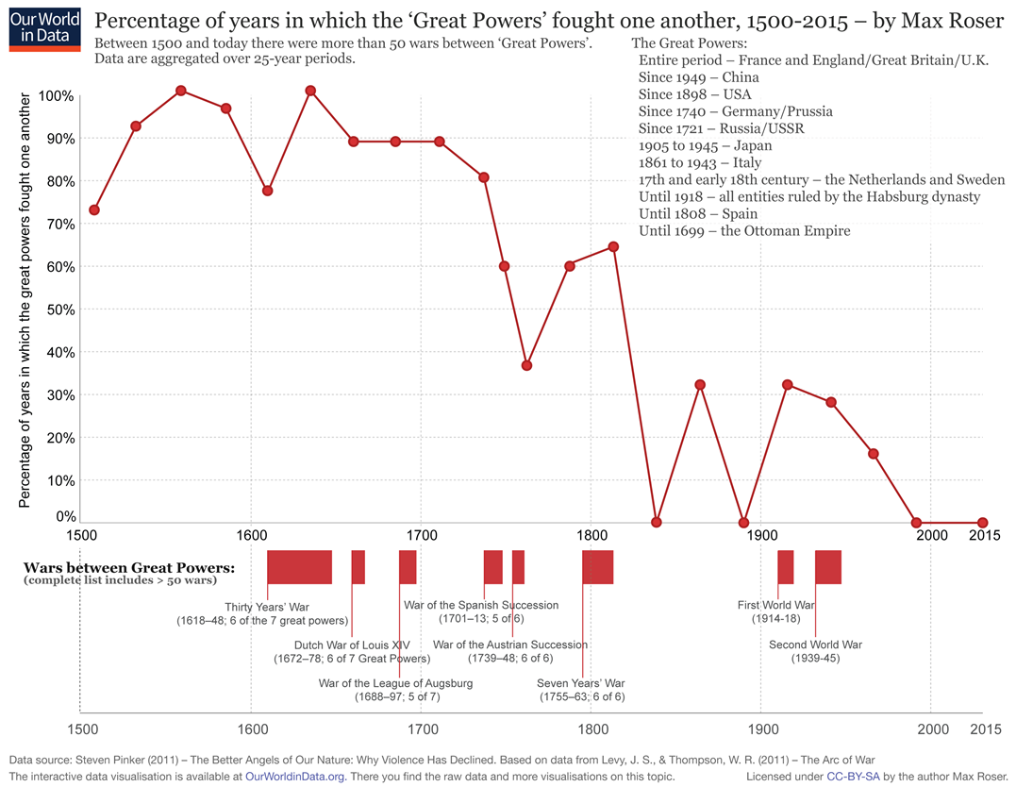

Slide 9
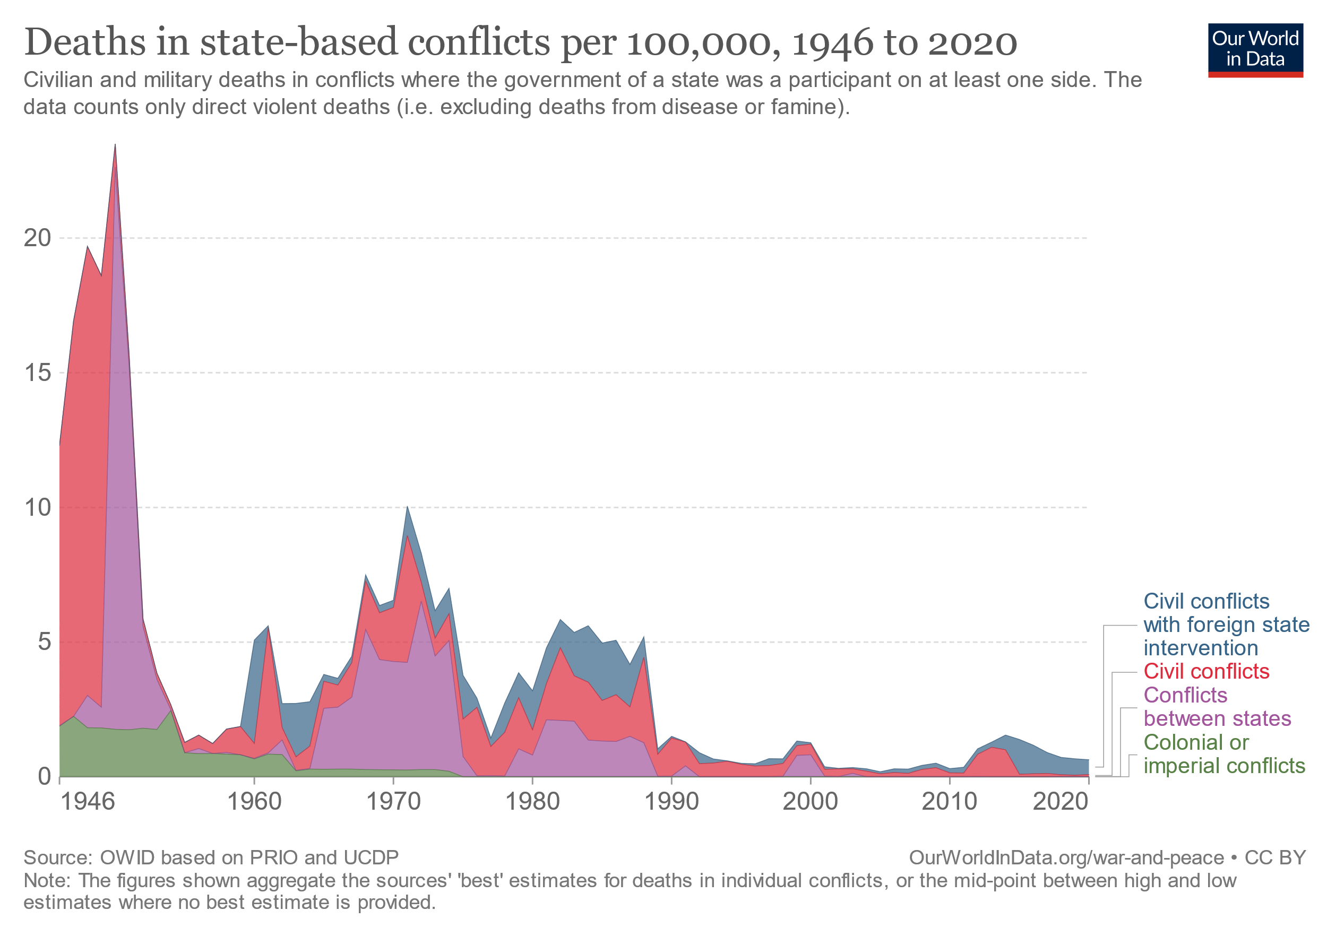

Slide 10
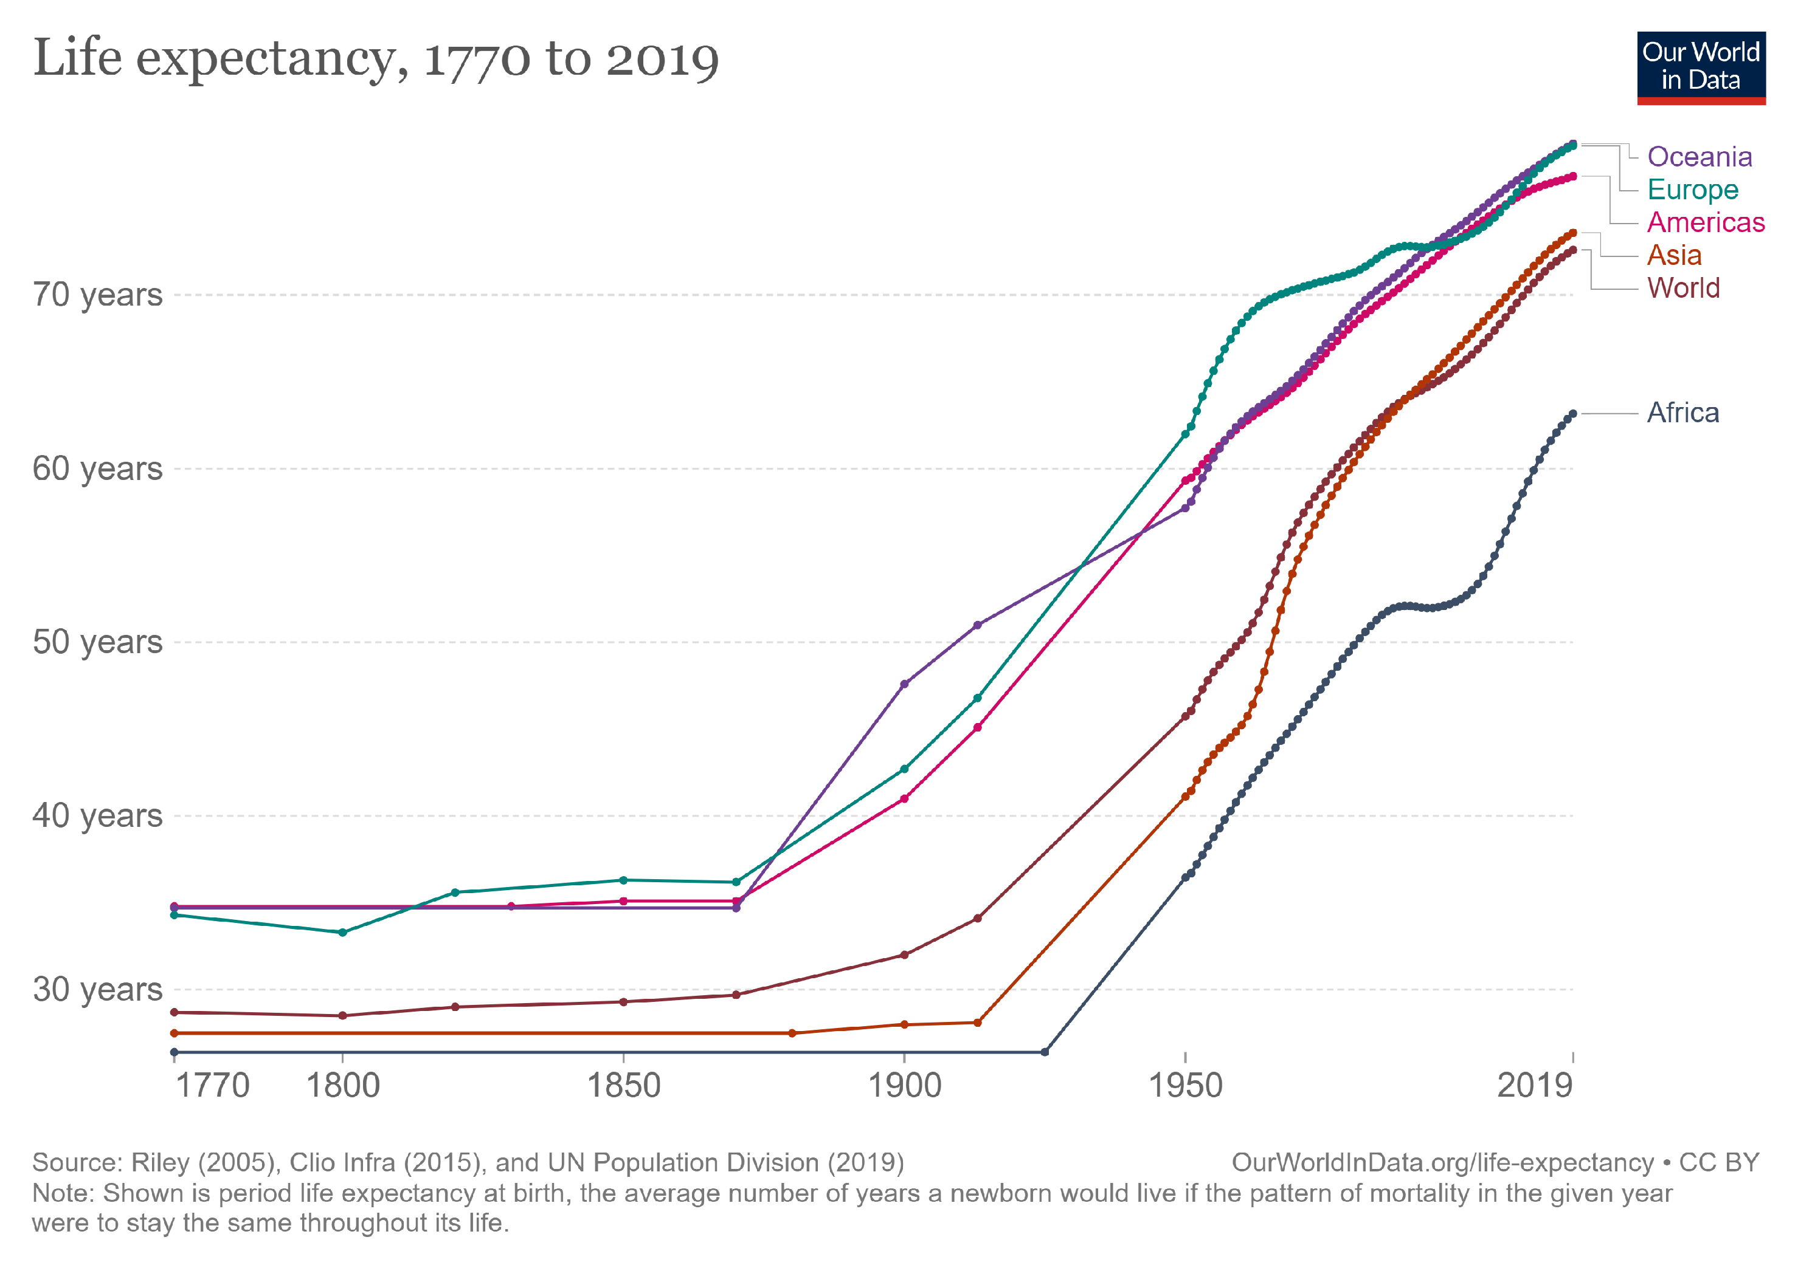

Slide 11
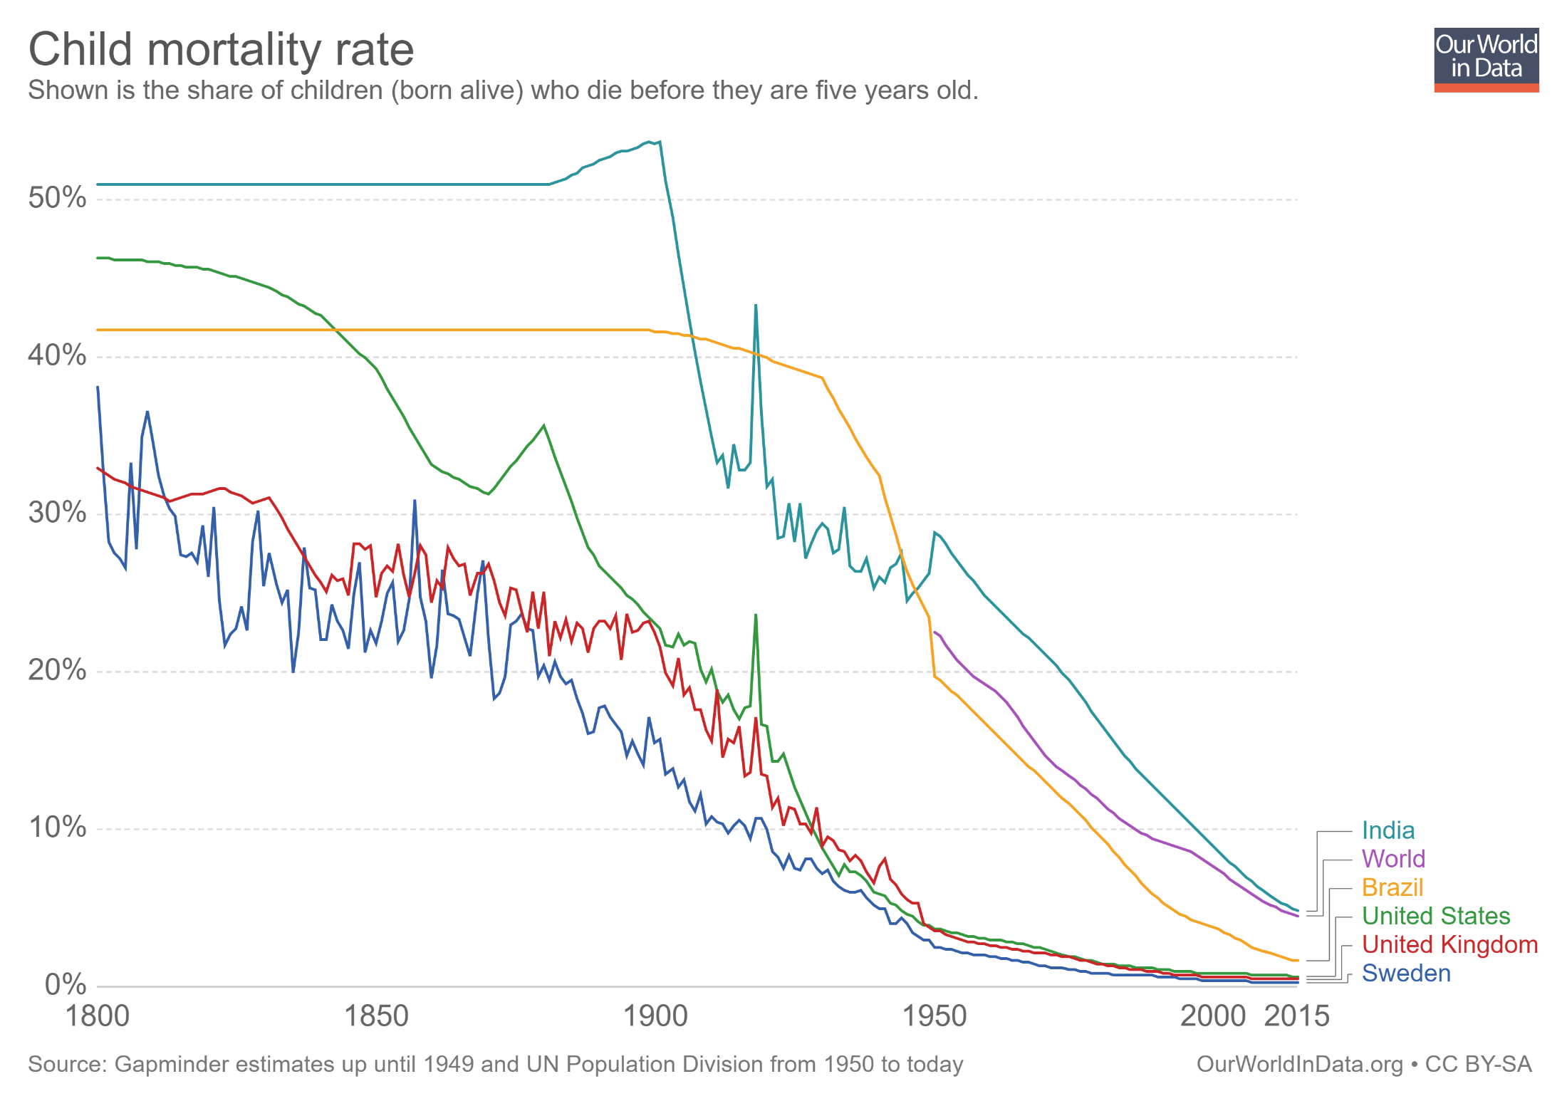

Slide 12
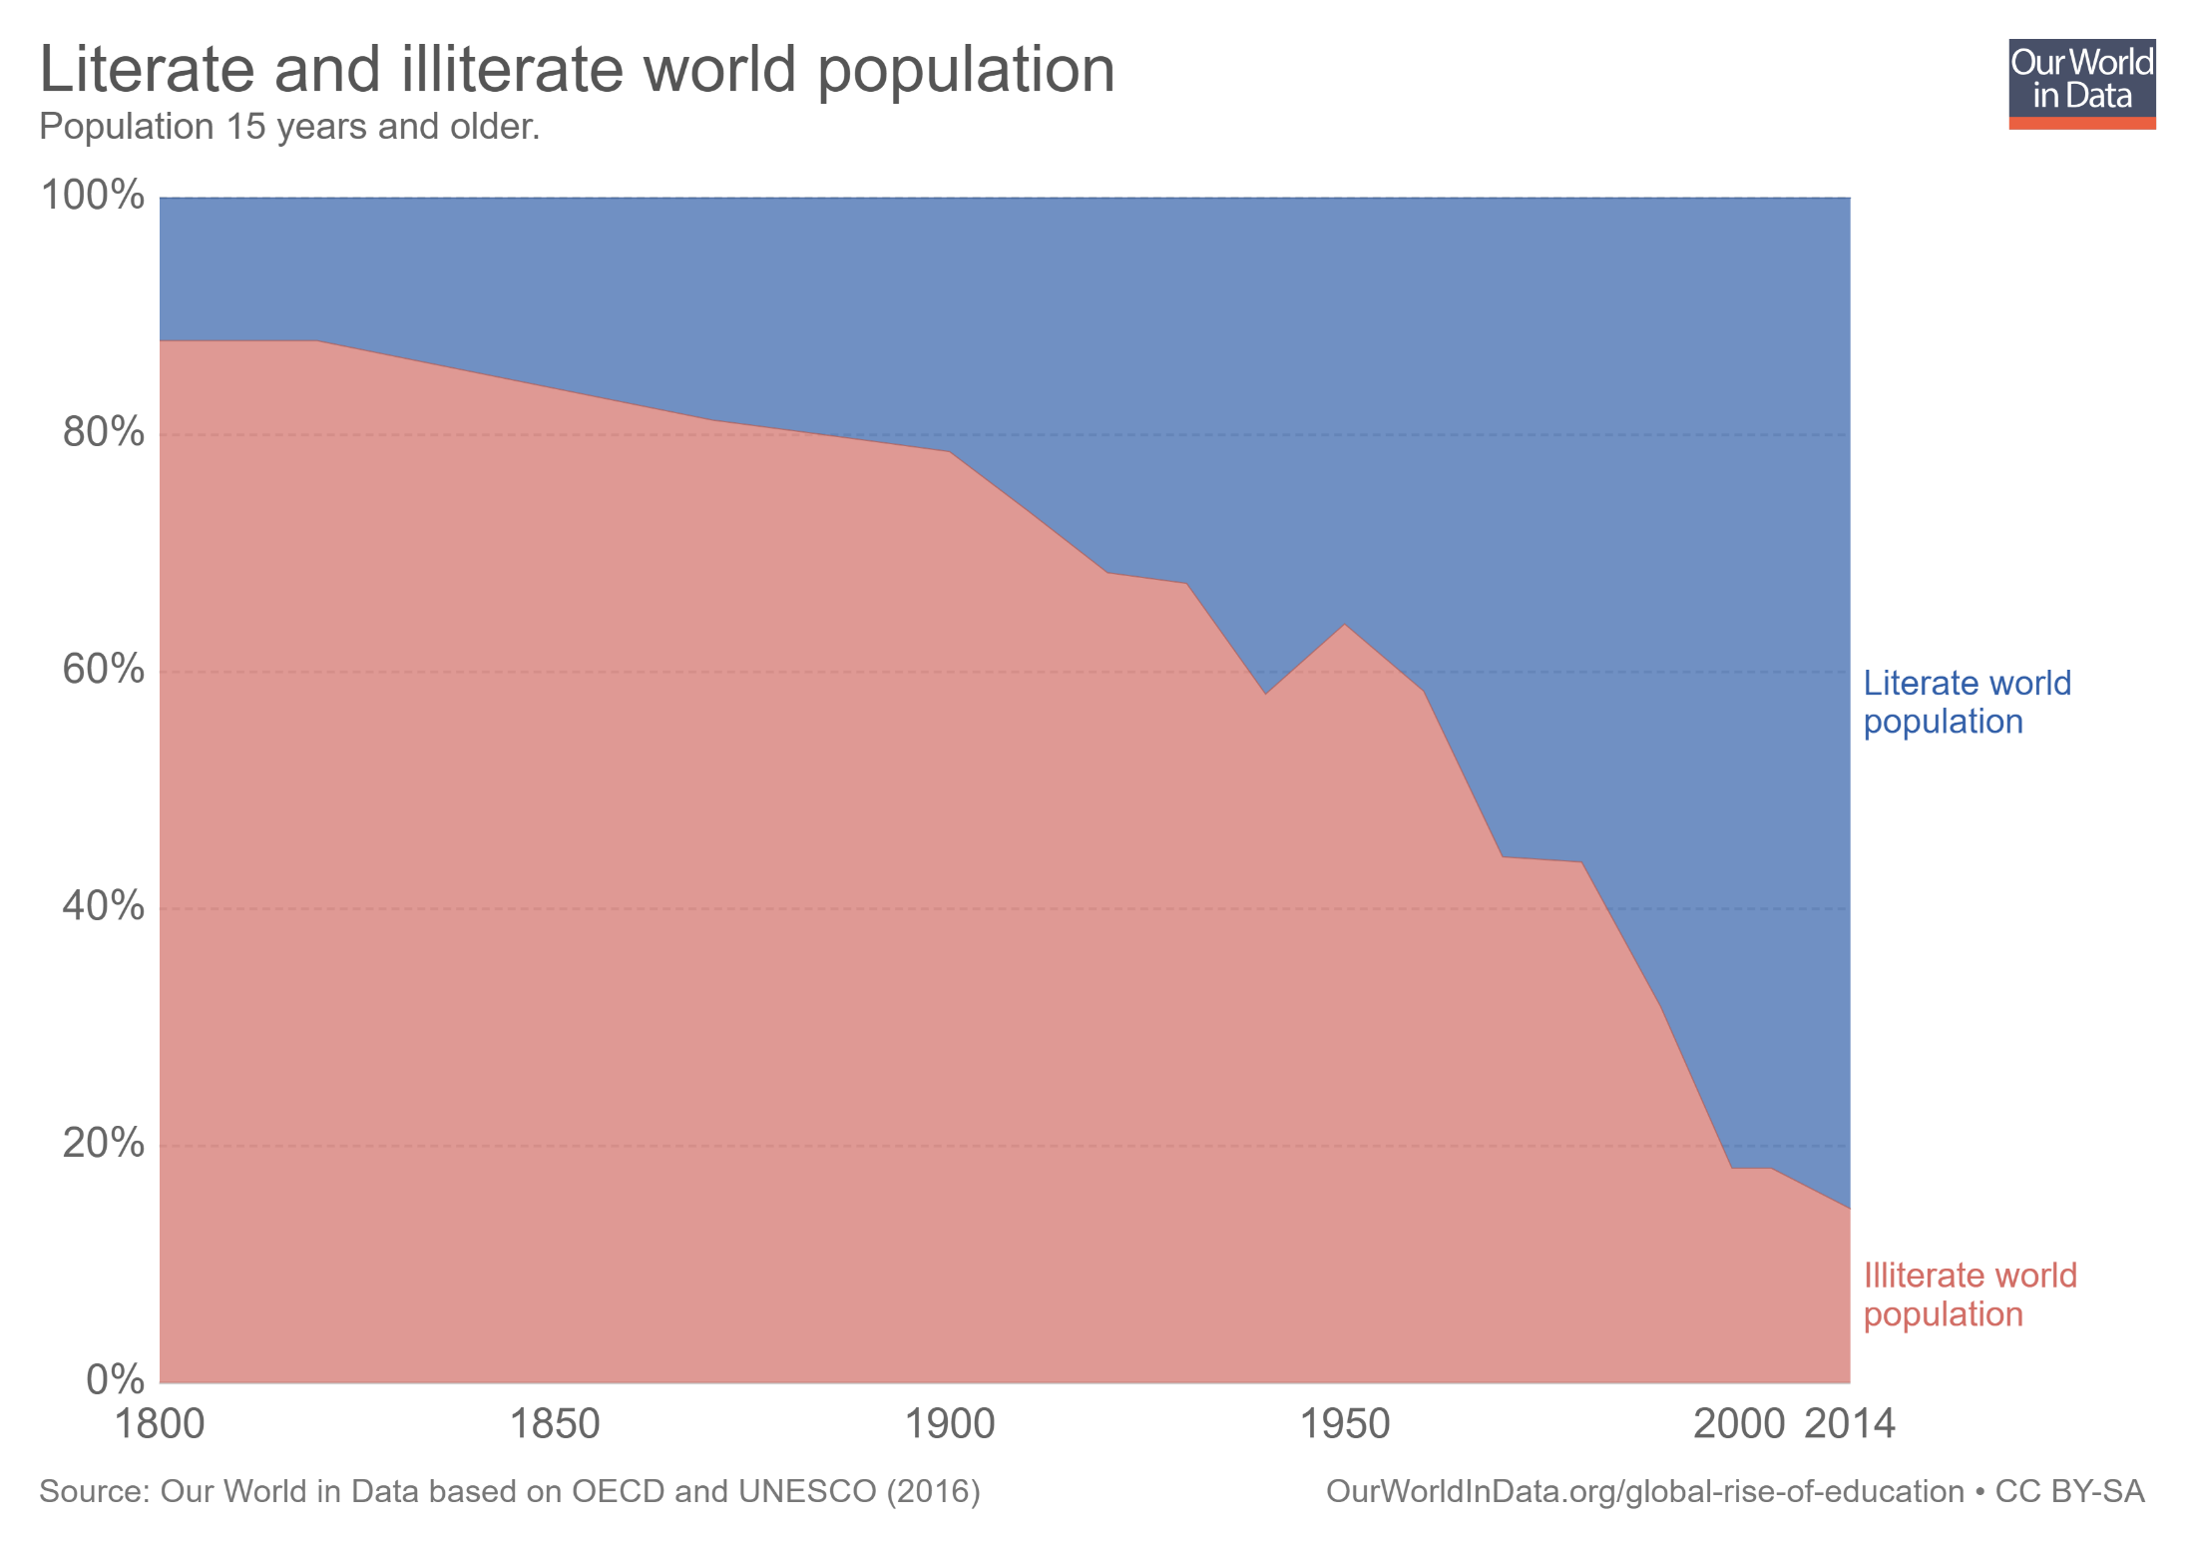

Slide 13
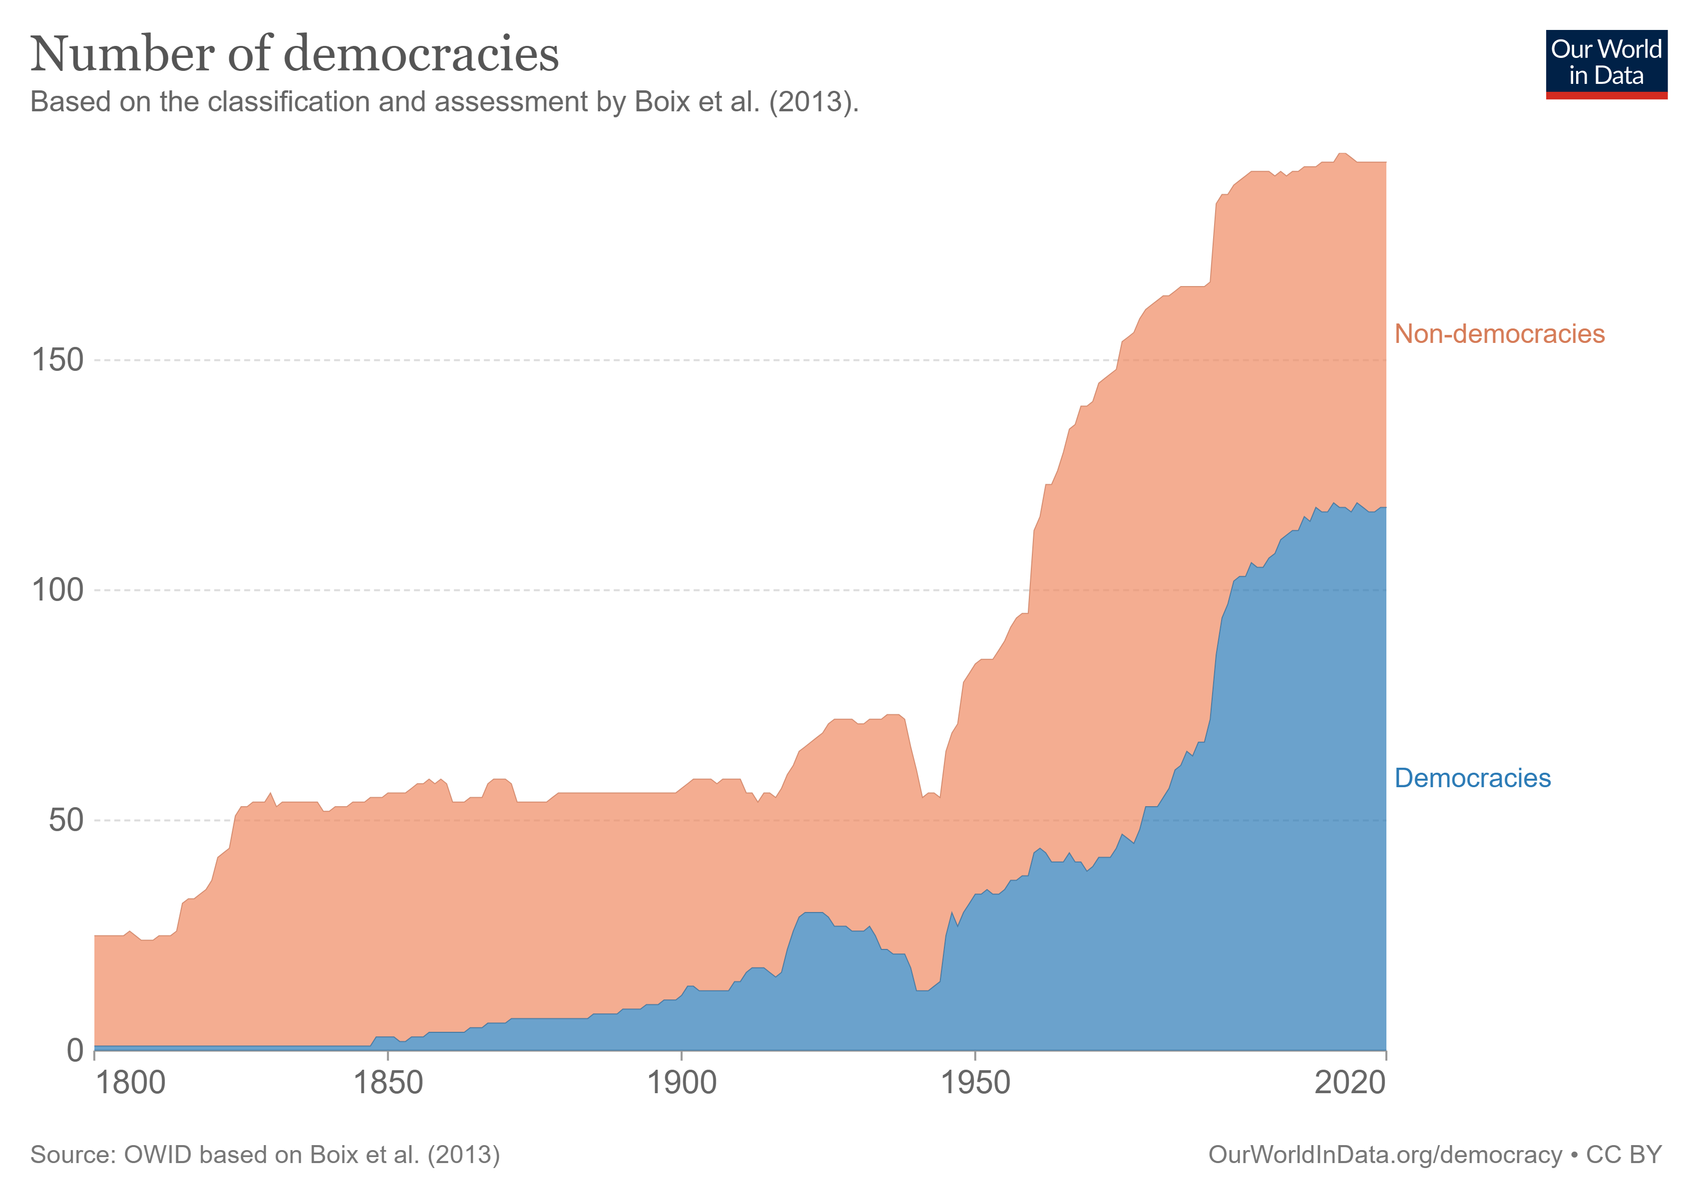

Slide 14
WE CAN PREVENT VIOLENT CONFLICT… AND WHEN WE DO, EVERYTHING ELSE IMPROVES

Slide 16
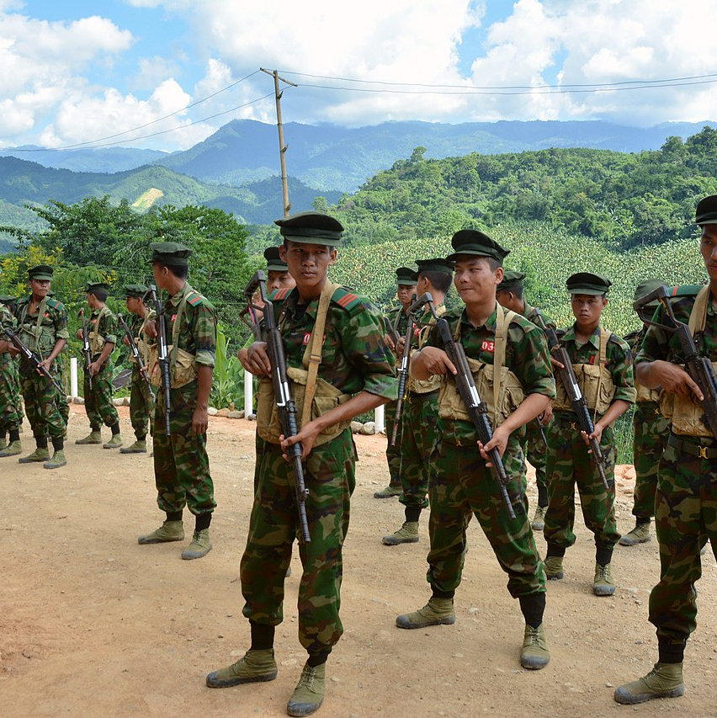
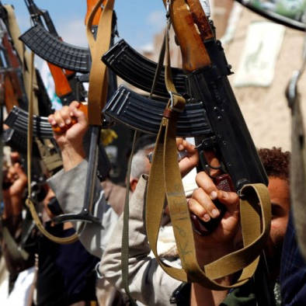
Post-WWII system struggles to cope with…
Civil Wars &
Collapsing States
Non-State
Armed Groups

Slide 17
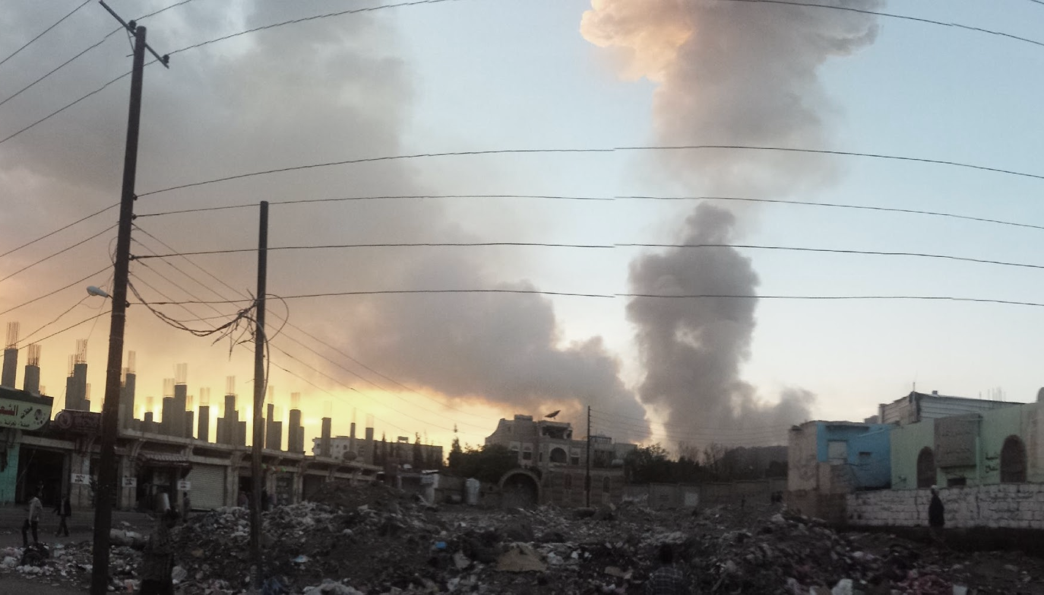
Modern Conflict (since 2000)
Less Cooperation &
More Violence
Resurgent
Interstate Conflict
Destabilizing
Non-State
Forces

Slide 18
Less cooperation & more violence
“The pandemic is a clear test of international cooperation — a test we have essentially failed.”
-- UN Secretary-General António Guterres
Impact more widespread & severe than expected; extreme effects to which we can’t adapt are “locked in”; urgent action required
-- UN Intergovernmental Panel on Climate Change (March 2022 report)
“Conflicts drive 80% of all humanitarian needs…
Violent conflict is the primary cause of poverty & suffering”
-- World Bank Fragility, Conflict & Violence Report

Slide 19
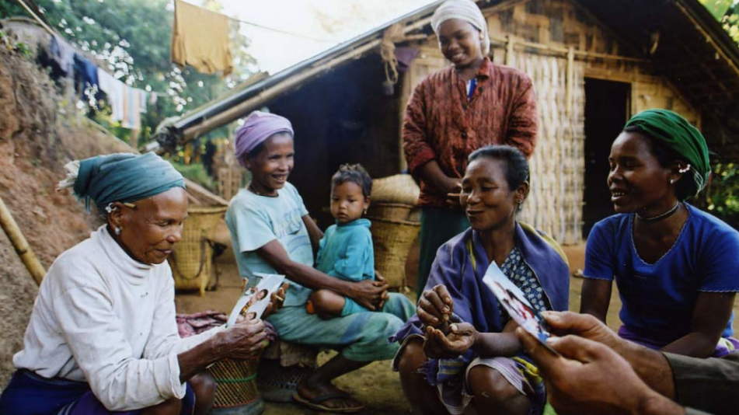
What We Know About
Preventing Violent Conflict
& Fostering Cooperation

Slide 20
SOCIETAL VITAL SIGNS
STANDARD MEASURES
TRUST BETWEEN COMMUNITES
TRUST IN INSTITUTIONS
SUSTAINABLE RESOURCING
VIOLENCE
AGENCY
EVERYDAY LIVED EXPERIENCE &
REFLECTIVE PRACTICE

Slide 21
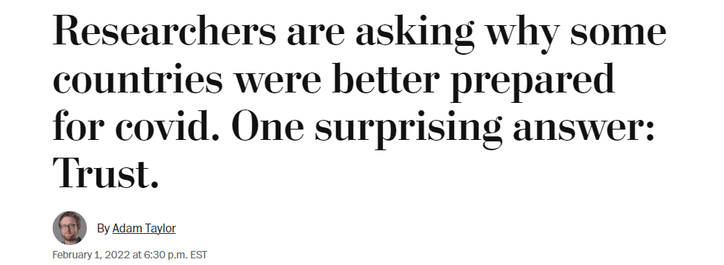

Slide 22
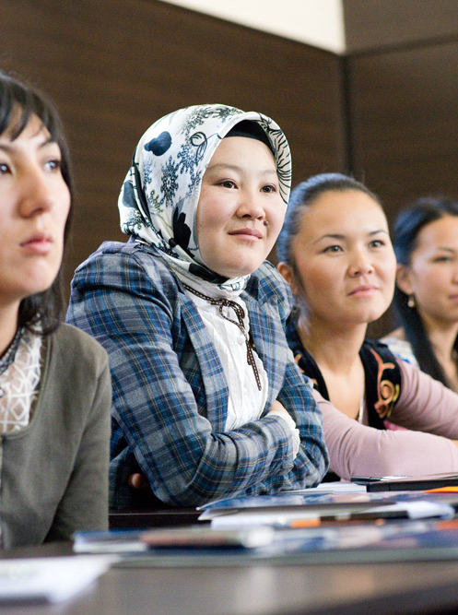
TRANSFORMING CONFLICT INTO COOPERATION
Connection
Use whatever works - sports; media;
back-channel negotiations –
to break down barriers.
Breakthroughs
Drive cooperation toward society-wide change via Institutions;
Social Norms; or Markets.
Collaboration
Support people to understand their differences;
act on their common ground.

Slide 23
POLICE-COMMUNITY RELATIONS IN THE DEMOCRATIC REPUBLIC OF CONGO
Country of 87 million
2010: “Rape capital of the world” – UN official
Today:
94%: the army provides better protection
80%: police treat me “courteously” (up from 50%)
Police: “citizens reach out to us for help!”
How we did it:
Connection: community plays, sports, mass media
Collaboration: coalitions, scorecards
Breakthrough: national reforms, 200K+ trained

Slide 24
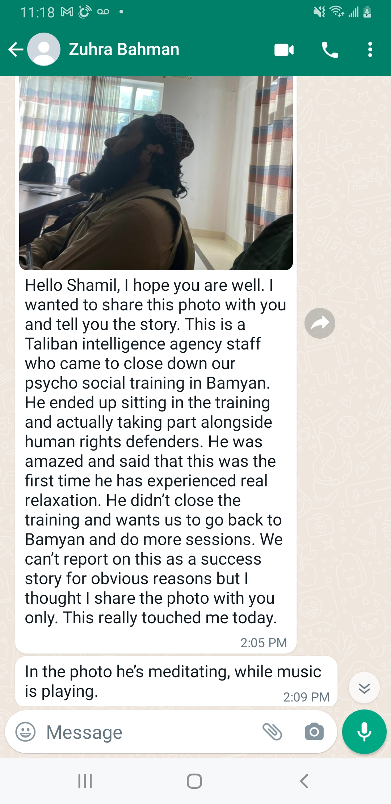

Slide 25
Take-Aways

Slide 26
Take-Aways
Conflict is inevitable, violence is not
When we manage conflict well, all other progress becomes possible
20th century system for managing conflict (state-to-state diplomacy) is insufficient for managing 21st century conflict: citizens & private sector key
Anyone can build peace: make connections; foster collaboration; work toward breakthroughs

Slide 27
Thank You!

